Slide 1
REQ 2 Environment
To add to slides of Luigi, at the beginning

Slide 2
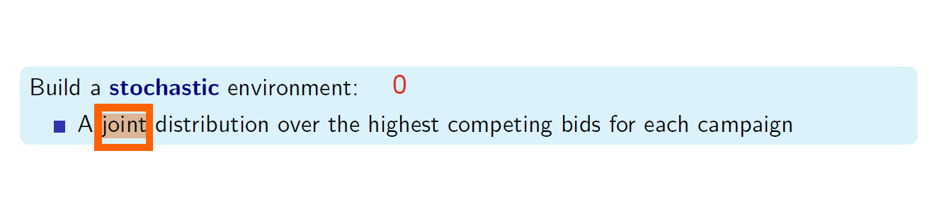
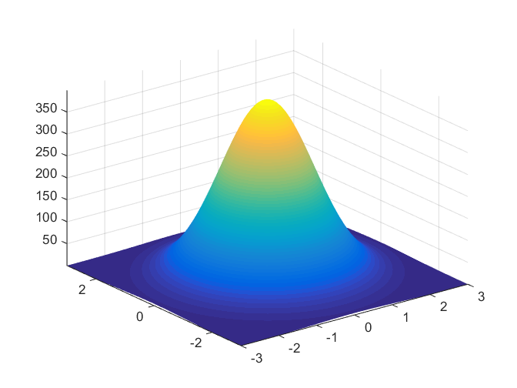
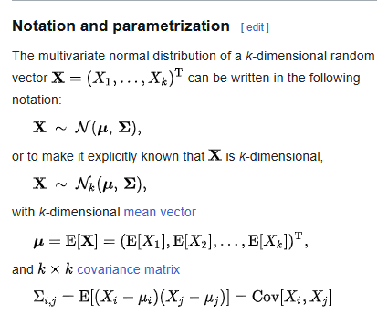

Slide 3
How I would set up φ₀ → the initial distribution
For the substitutes (eg Pepsi and coca cola) that bidders assume can’t bid on both I would model them having an high positive correlations. WHY? → if they are substitutes they should have similar demands (if one goes up for something special the other should follow)
Overall negative correlations: A single big advertiser's daily budget is finite — if they're bidding hard on campaign A today, they bid less on campaign B.
Some should have positive correlations because they are complimentary (eg Hotels <--> Flights)
Example Σ for 6 campaigns: C1–C2 substitutes (+), C3–C4 complementary (+), C5–C6 share one advertiser's budget (–)
 | C1 | C2 | C3 | C4 | C5 | C6
C1 | 1.00 | +0.80 | +0.05 | 0.00 | -0.10 | 0.00
C2 | +0.80 | 1.00 | 0.00 | +0.05 | 0.00 | -0.10
C3 | +0.05 | 0.00 | 1.00 | +0.60 | -0.15 | 0.00
C4 | 0.00 | +0.05 | +0.60 | 1.00 | 0.00 | -0.15
C5 | -0.10 | 0.00 | -0.15 | 0.00 | 1.00 | -0.50
C6 | 0.00 | -0.10 | 0.00 | -0.15 | -0.50 | 1.00

Slide 4
Req 4 environment
Previous to Ale’s talk

Slide 5
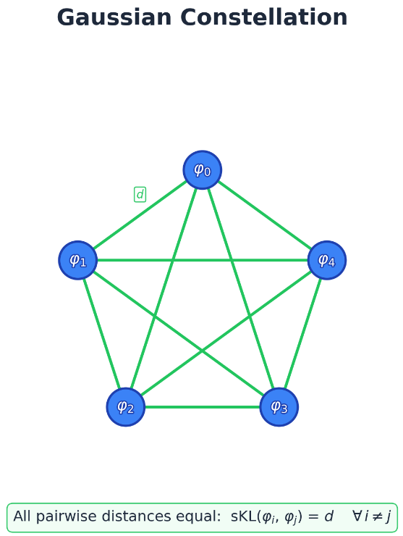
Gaussian Constellation
The goal: generate a series of gaussians all equi-divergent (or with a bounded divergence). They will represent our modes of the market.

Slide 6
REQ 4: Environment: Highly Non-Stationary Constellation Model
Objective: build a highly-nonstationary multi-campaign environment(competing bids change rapidly over time)
Core idea: Constellation –based environment:
Define a set of fixed “market states”(‘stars’) , where each state(star) is a full competing-bid vector
For example: If we have 4 campaigns:
star_0 = φ₀(μ₀, Σ₀) star_1 = φ₁(μ₁, Σ₁) star_2 = φ₂(μ₂, Σ₂) star_4 = φ₃(μ₃, Σ₃)
Where:
star_0: is a fixed star that could be randomly sampled or even better introduced by hand. From there we rototranslate it to have different kind of distributions

Slide 7
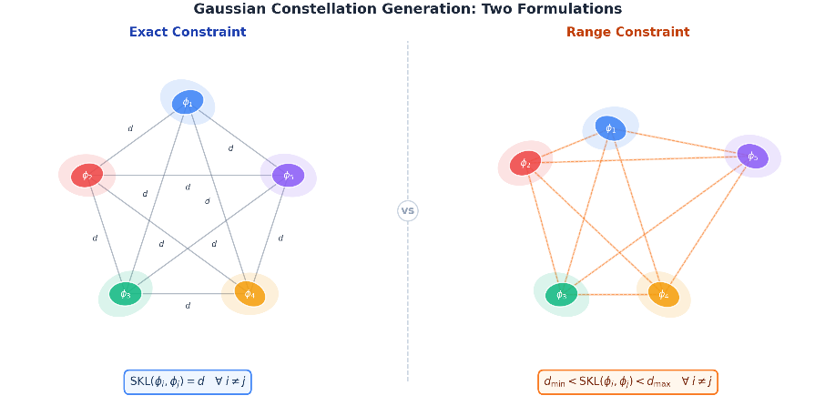

Slide 8

How would it work?

Slide 9
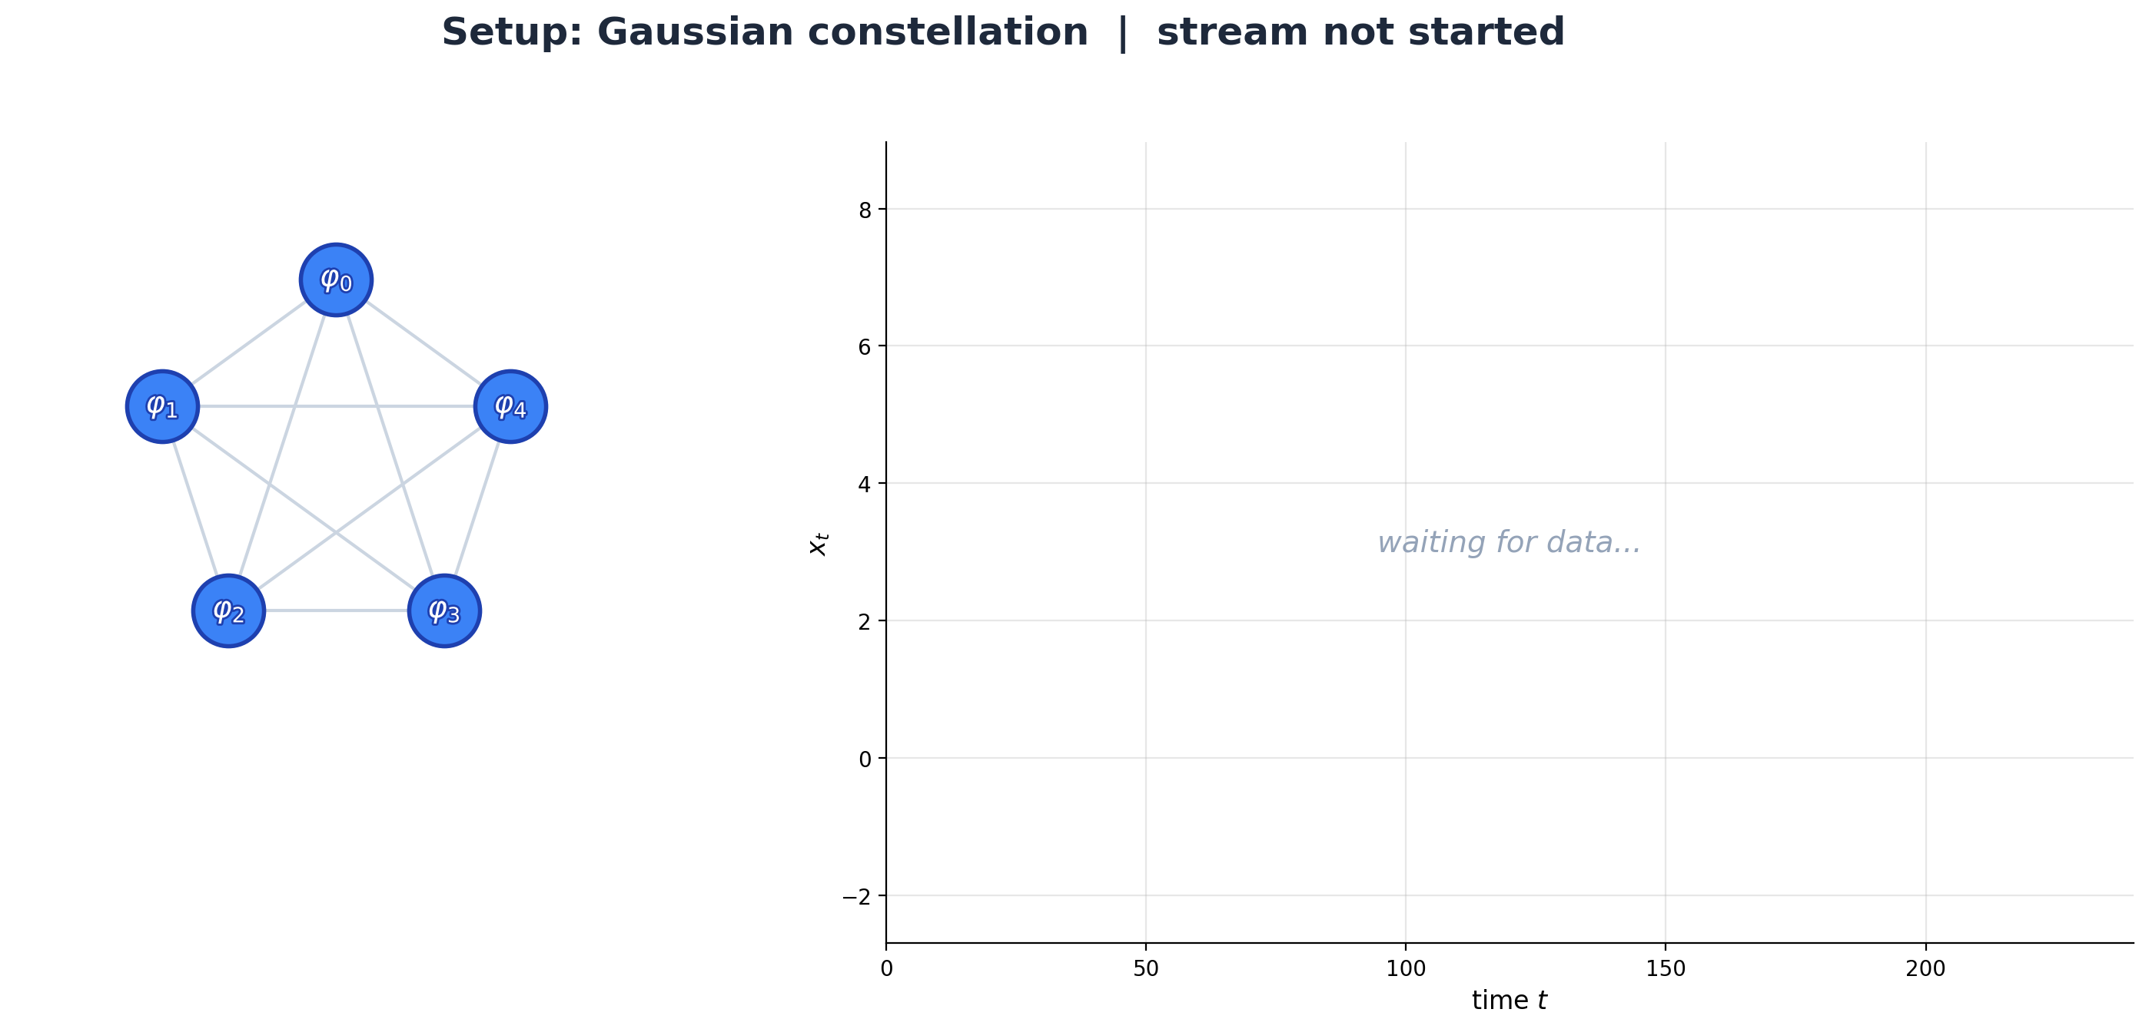

Slide 10
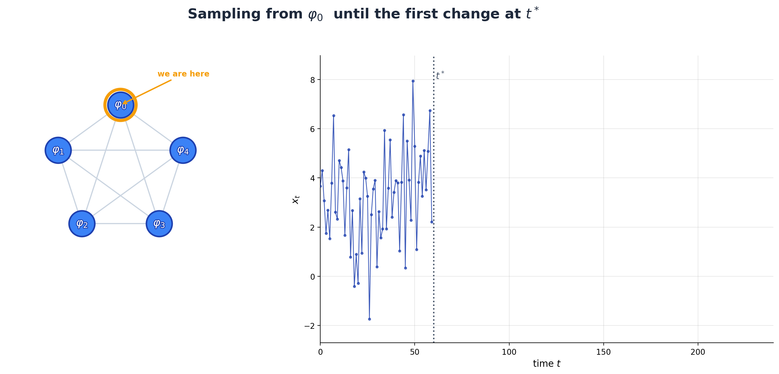

Slide 11
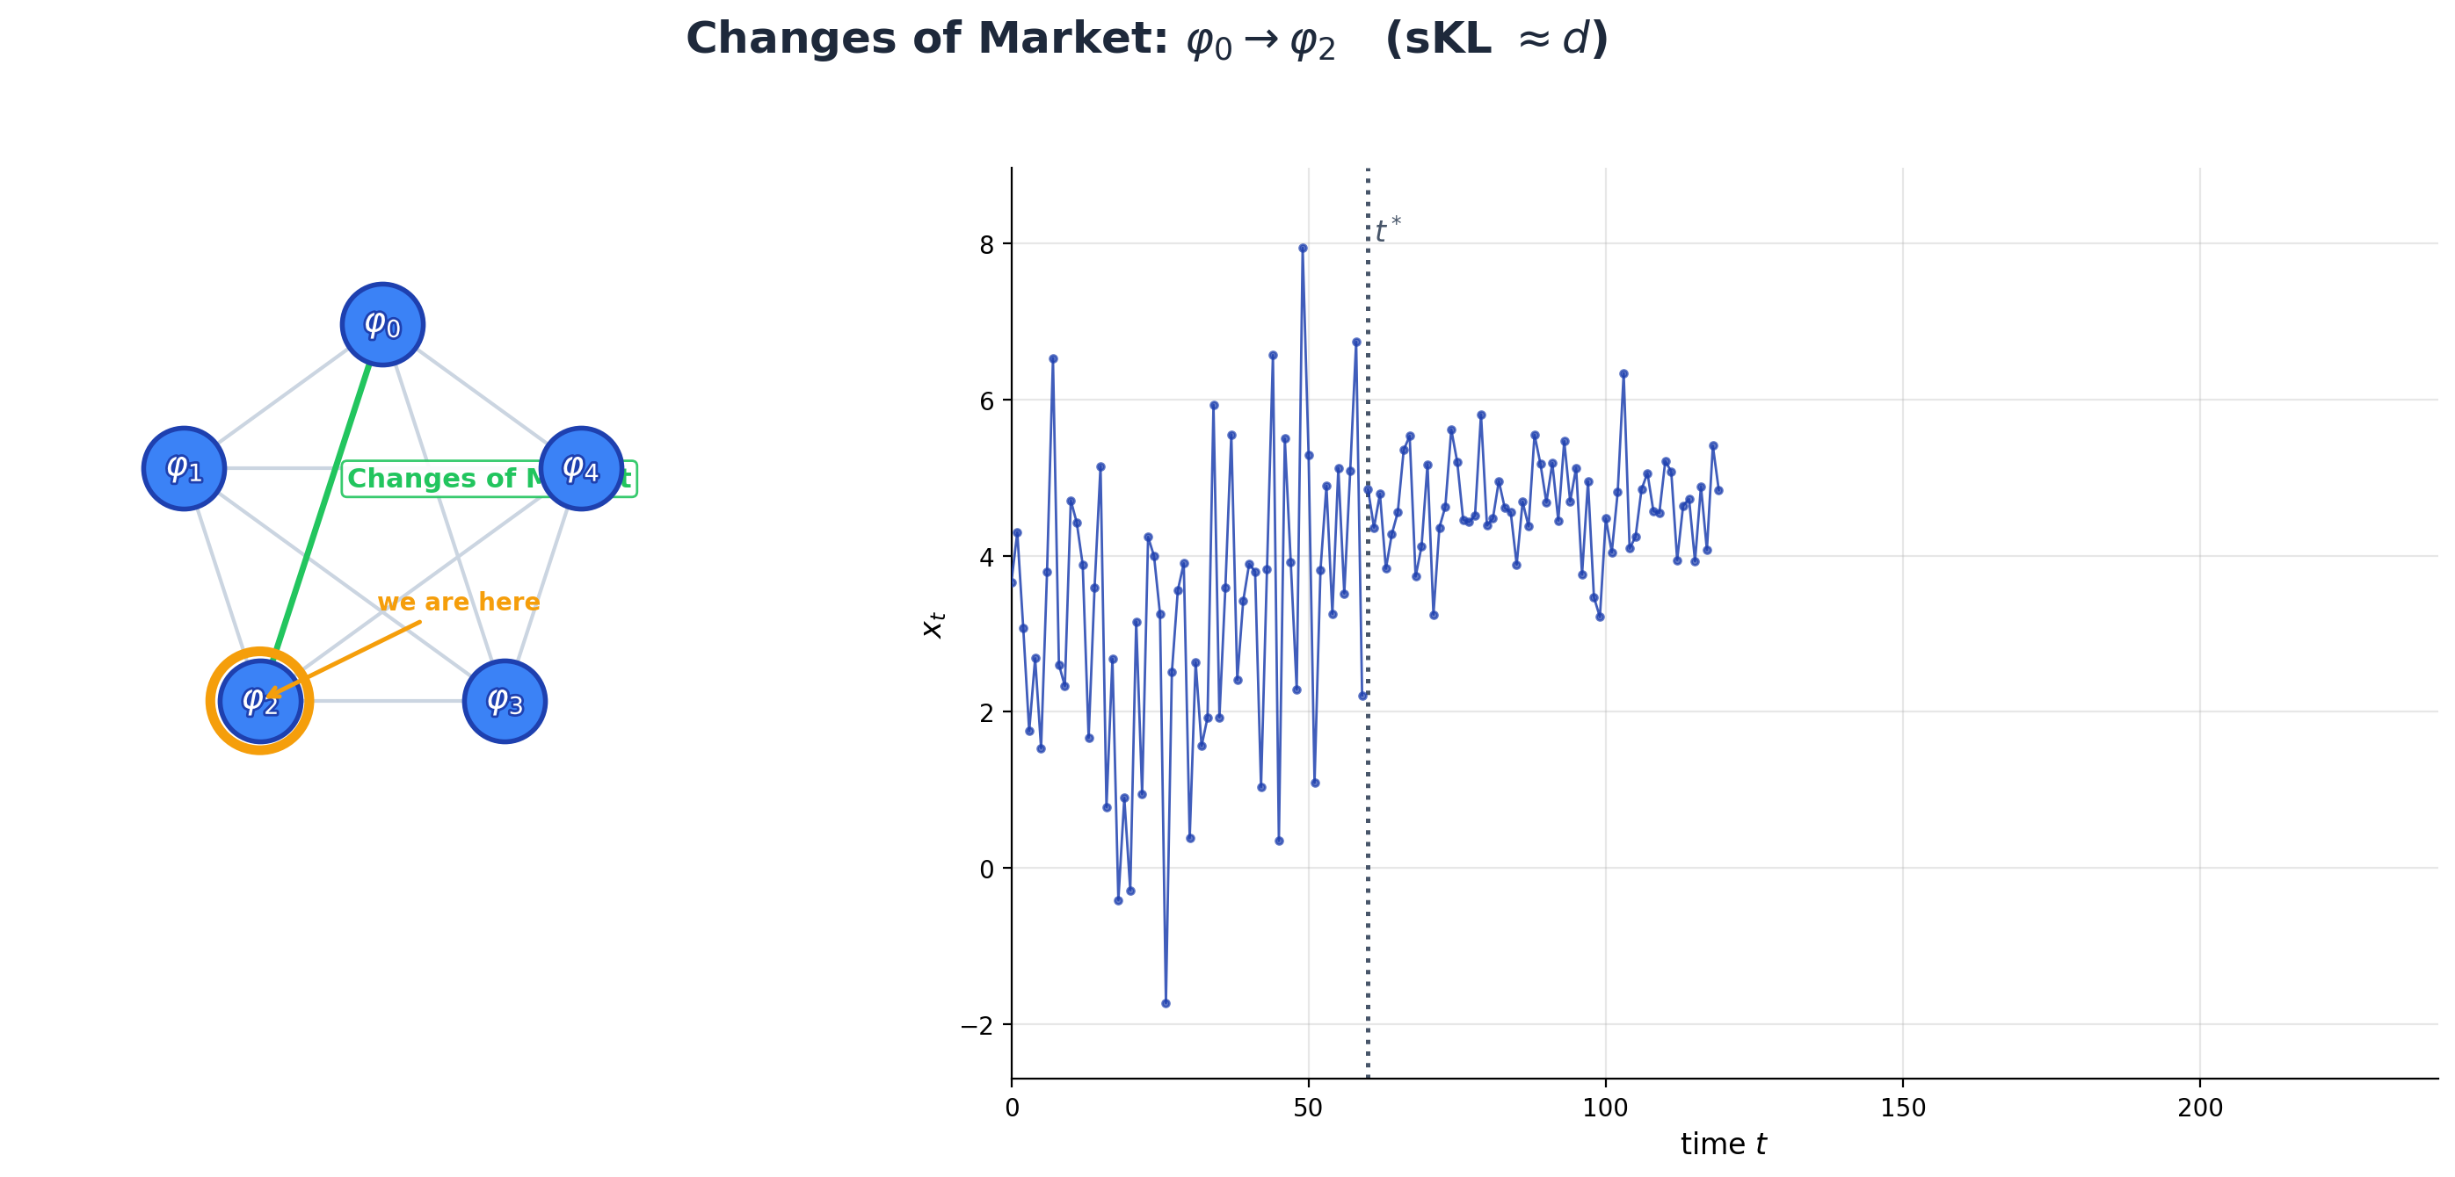

Slide 12
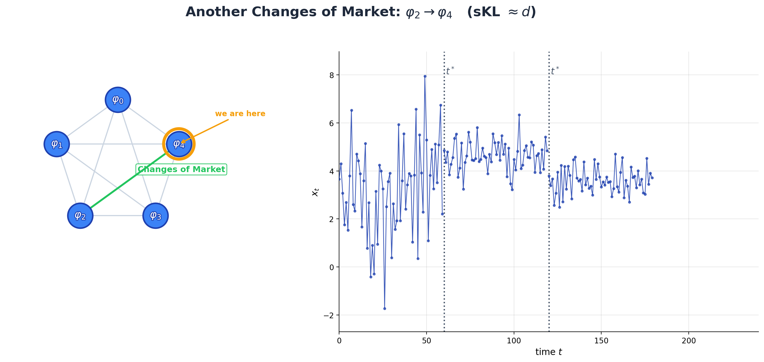

Slide 13
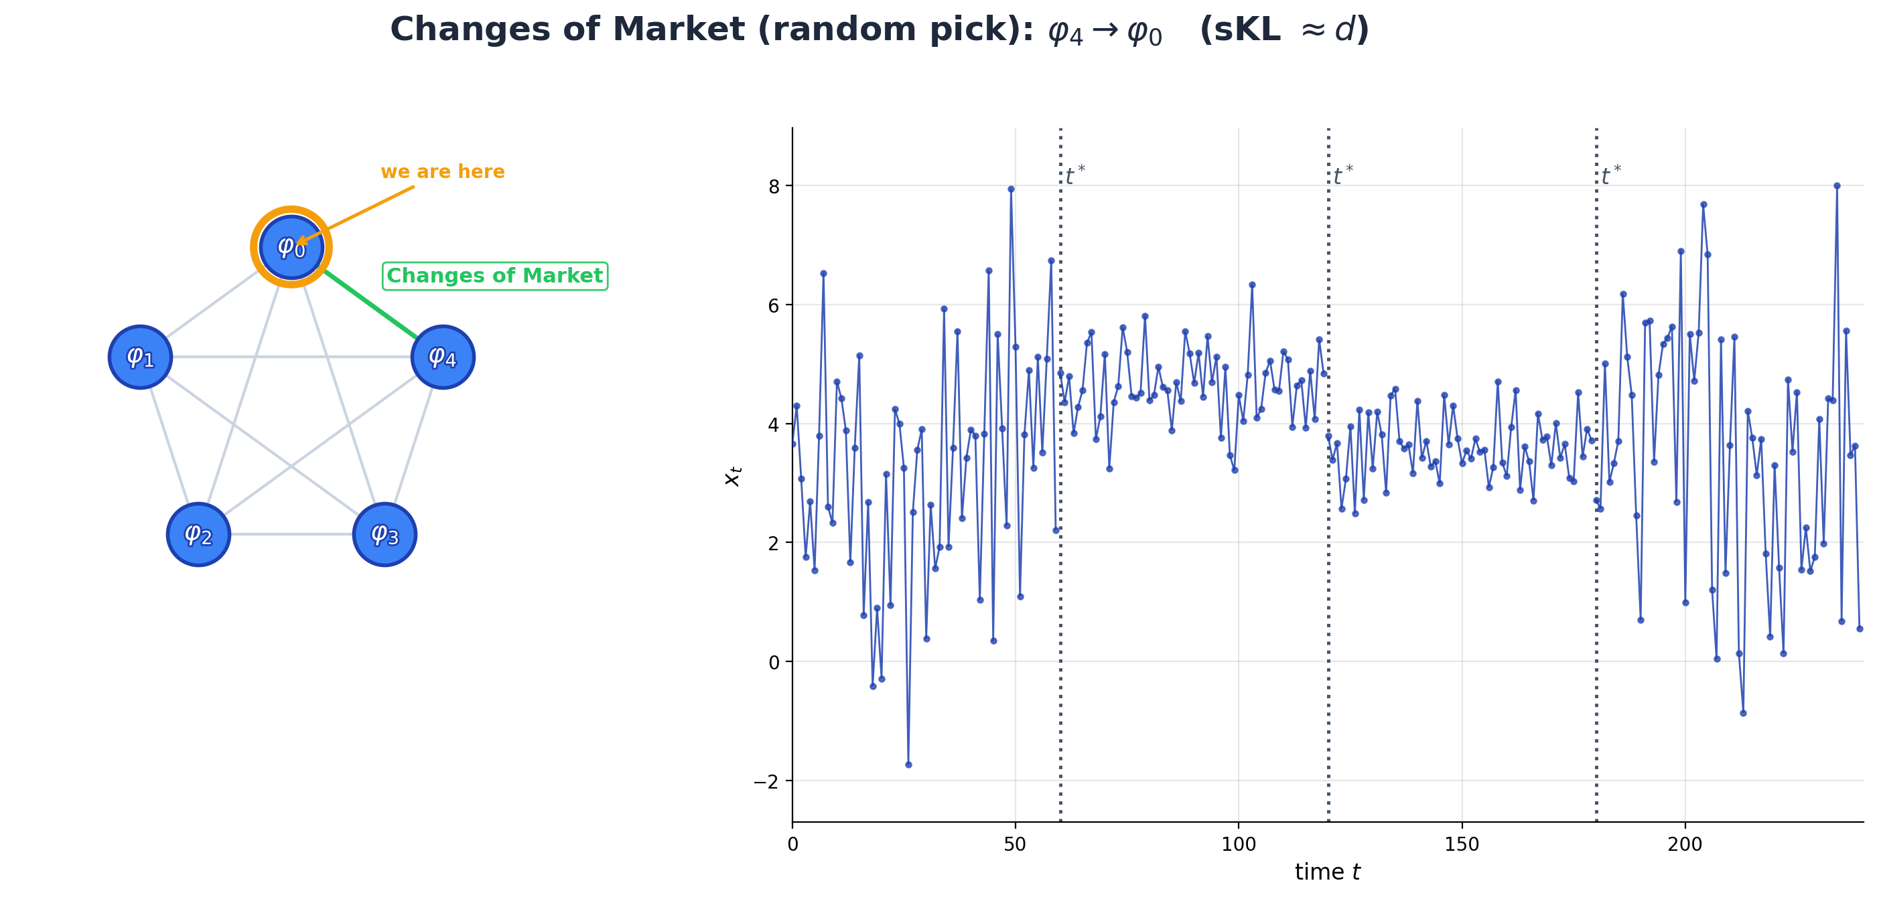

Slide 14
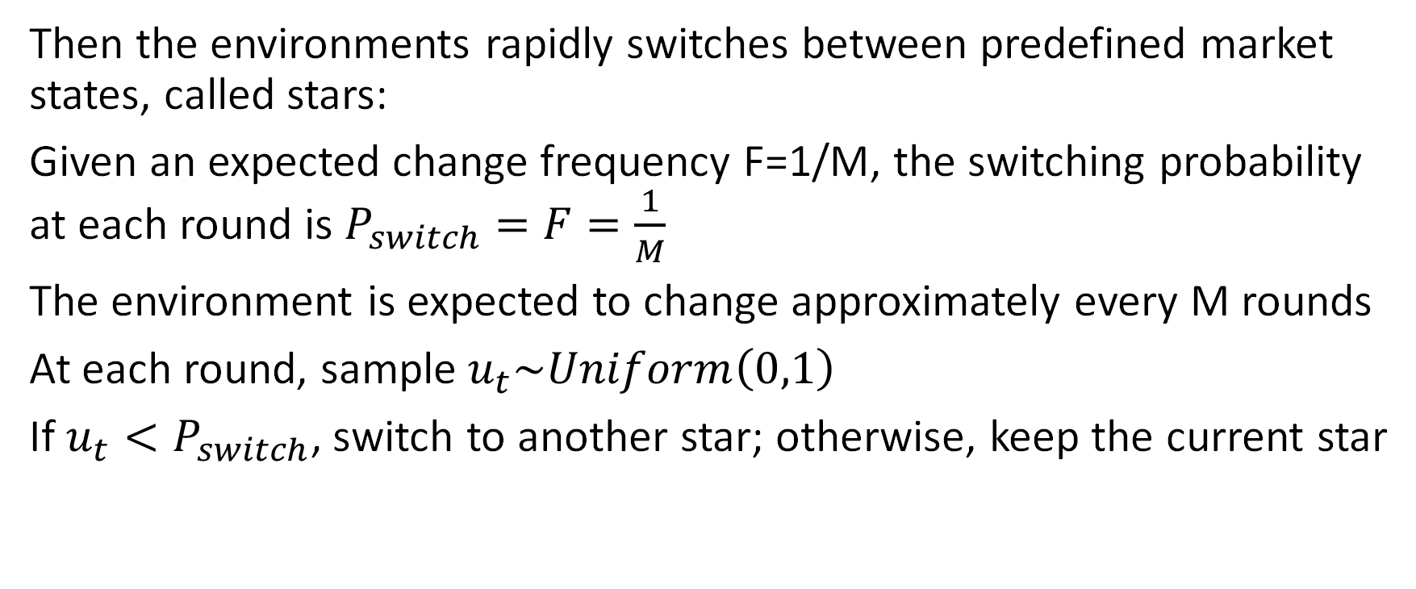
Switching mechanism
Then the environments rapidly switches between predefined market states, called stars:
Given an expected change frequency F=1/M, the switching probability at each round is $P_{switch}=F=\frac{1}{M}$
The environment is expected to change approximately every M rounds
At each round, sample $u_{t}\sim Uniform\left(0,1\right)$
If $u_{t}<P_{switch}$, switch to another star; otherwise, keep the current star

Slide 15
Why do we need a Gaussian Constellation?

Slide 16
Same sKL
It is crucial that every star (representing a distribution) of our constellation φi has predefined sKL from all the other φj.
WHY?
Because Task 4b will be about change detection test. It could be important then to assess the goodness of the results based on a series of experiments with the same difficulty --> same sKL
On this synthethic data we need to know EVERYTHING and ideally we would love to set how "adversarial" the environment is. This can be controlled through the this framework. As we will see sKL is a good measure for measuring how adversarial the env is.
(why sKL is a good indicator of how adversarial or how hard are the tests is on the next slide)

Slide 17
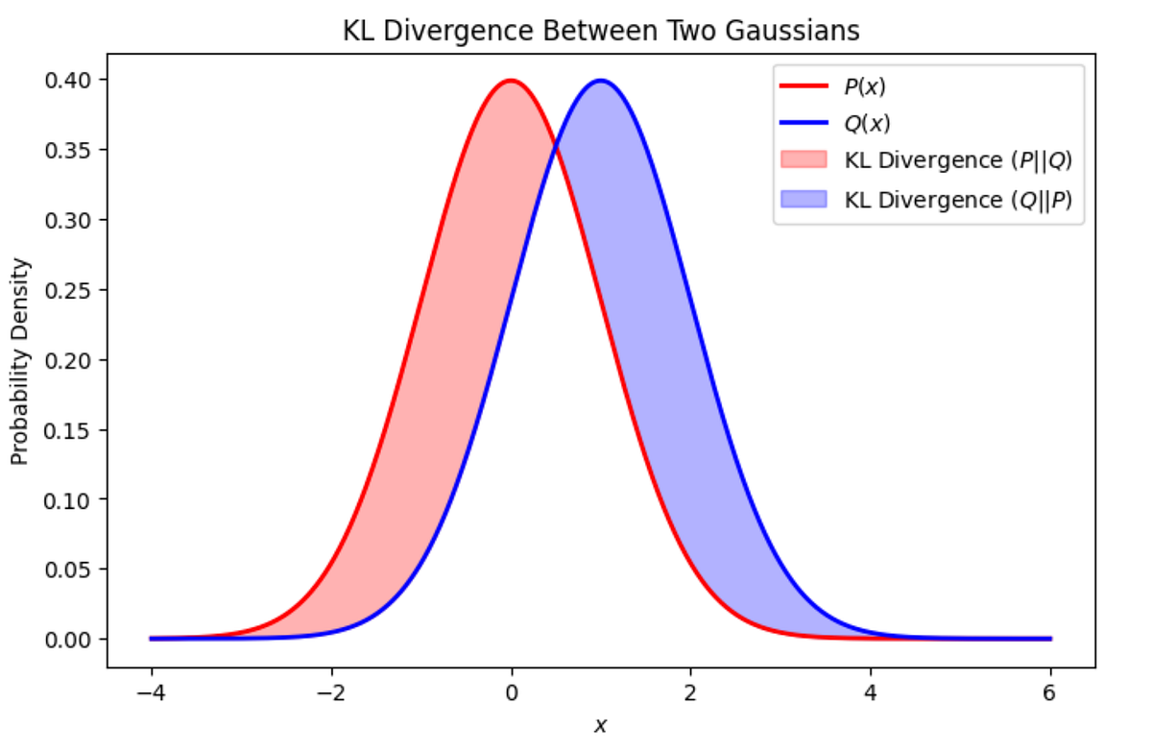
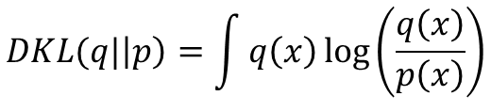
sKL divergence
.
Simple Shifts Fail
Manually adjusting the mean μ or covariance Σ is insufficient. Identical parameter shifts can result in vastly different detection difficulties depending on the underlying geometry of the base distribution.
KL and Stein’s lemma to the Rescue
Previous works, and Chernoff-Stein Lemma assures us that detection difficulty depends on the Kullback–Leibler (KL) divergence. Therefore, the objective is to generate data with a specific Symmetric KL (SKL) divergence between pairs.
$$DKL(q|\left|p\right)=\int{q\left(x\right)\log\left(\frac{q\left(x\right)}{p\left(x\right)}\right)}$$
$D_{sym}(q|\left|p\right)=$ $DKL(q|\left|p\right)+DKL(p|\left|q\right)$

Slide 18
Solutions to the Gaussian constellation problem
?

Slide 19
Possible solutions
Use rejection sampling similar + ccm (•Generating High-Dimensional Datastreams for Change Detection Diego Carrera, Giacomo Boracchi).
Use OGD : from our experimentation an upgrade to previous existing versions. On the extra material we have a complete performance analysis + theoretical reasons why we think our method is better.
References:
Generating High-Dimensional Datastreams for Change Detection D. Carrera, G. Boracchi
Multimodal Batch-wise Change Detection D. Stucchi, G. Boracchi, L. Magri, D. Carrera*
*Note: this paper imposed just a lower bound on the SKL divergence.

Slide 20
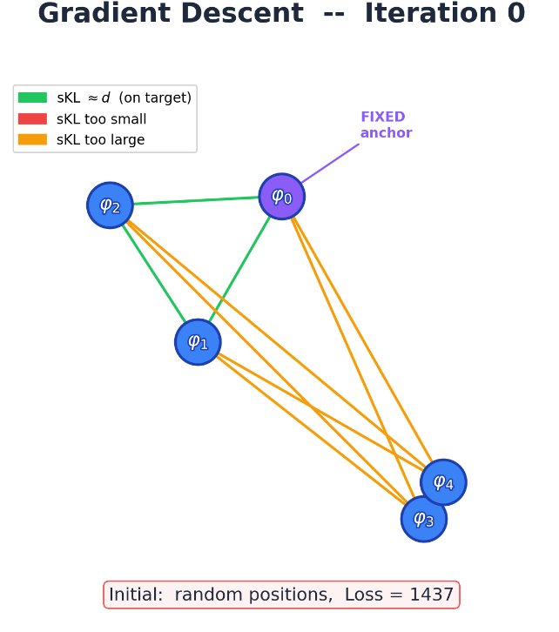
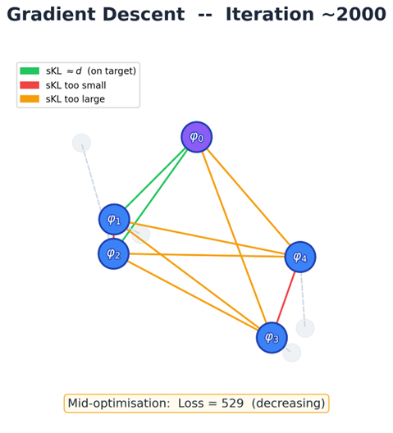
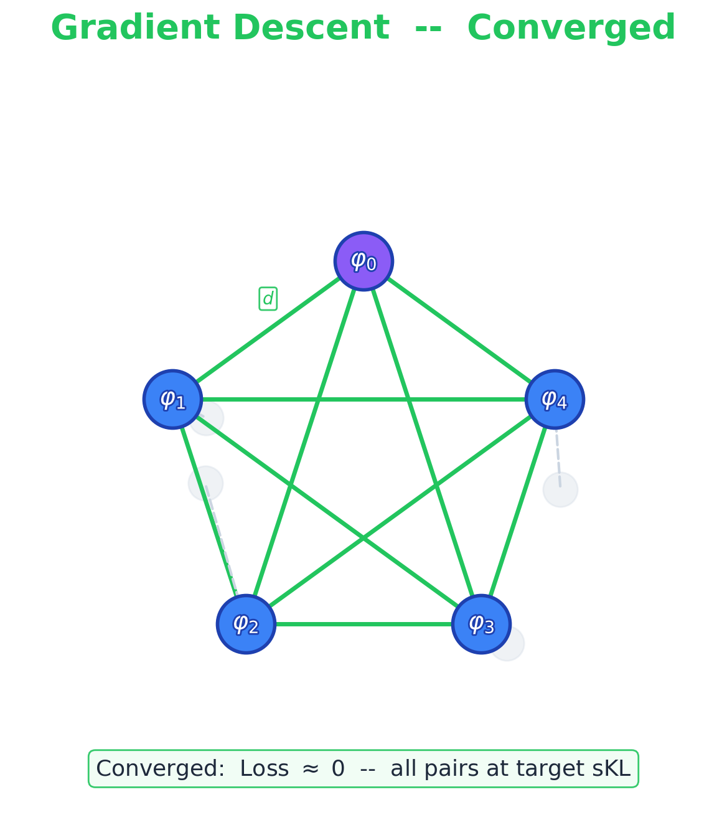
Online Gradient descent
Instead of adding a mode one by one at the beginning we randomly distribute the parameter of all N of our gaussians and then we manipulate the gaussians to slowly converge to the solution.
Anchor could be a gaussians with good values of mean and std dev.

Slide 21
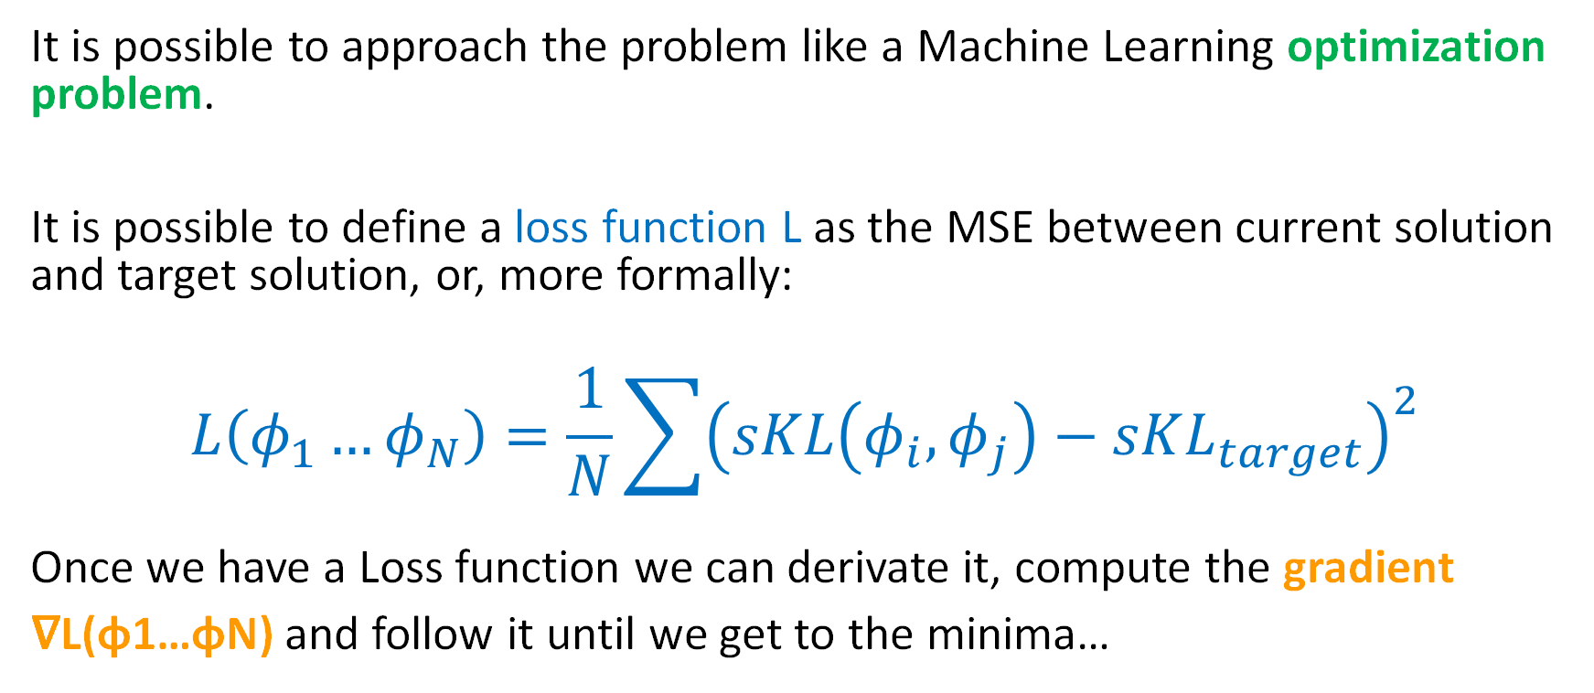
How it works
It is possible to approach the problem like a Machine Learning optimization problem.
It is possible to define a loss function L as the MSE between current solution and target solution, or, more formally:
$$L\left(φ_{1}…φ_{N}\right)=\frac{1}{N}\sum{{\left(sKL\left(φ_{i},φ_{j}\right)−sKL_{target}\right)}^{2}}$$
Once we have a Loss function we can derivate it, compute the gradient
∇L(φ1…φN) and follow it until we get to the minima…

Slide 22
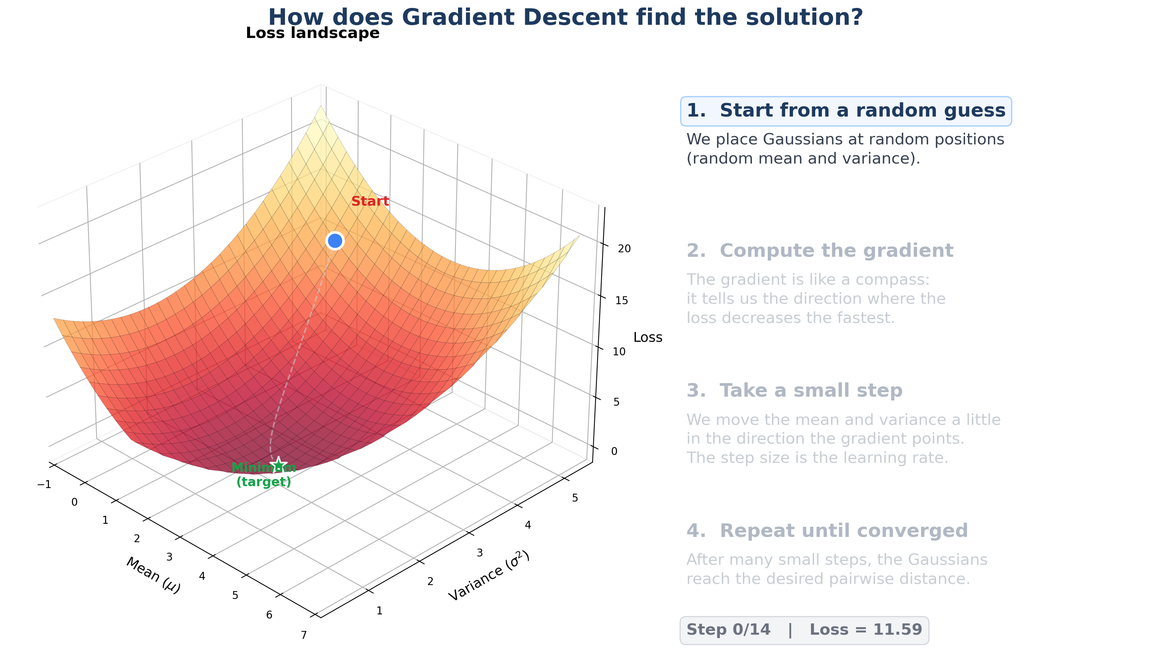

Slide 23
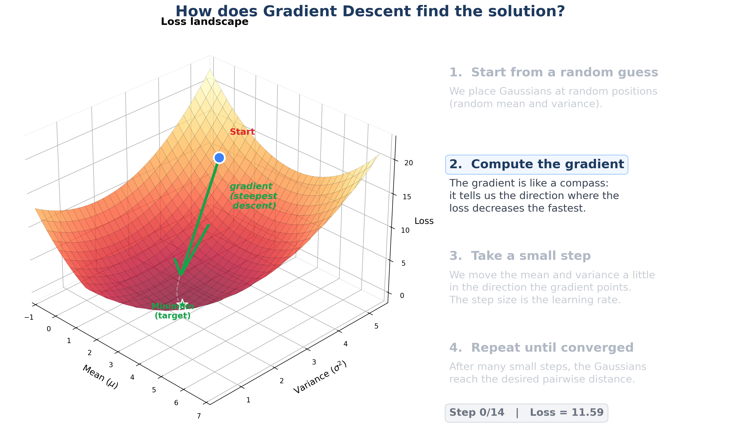

Slide 24
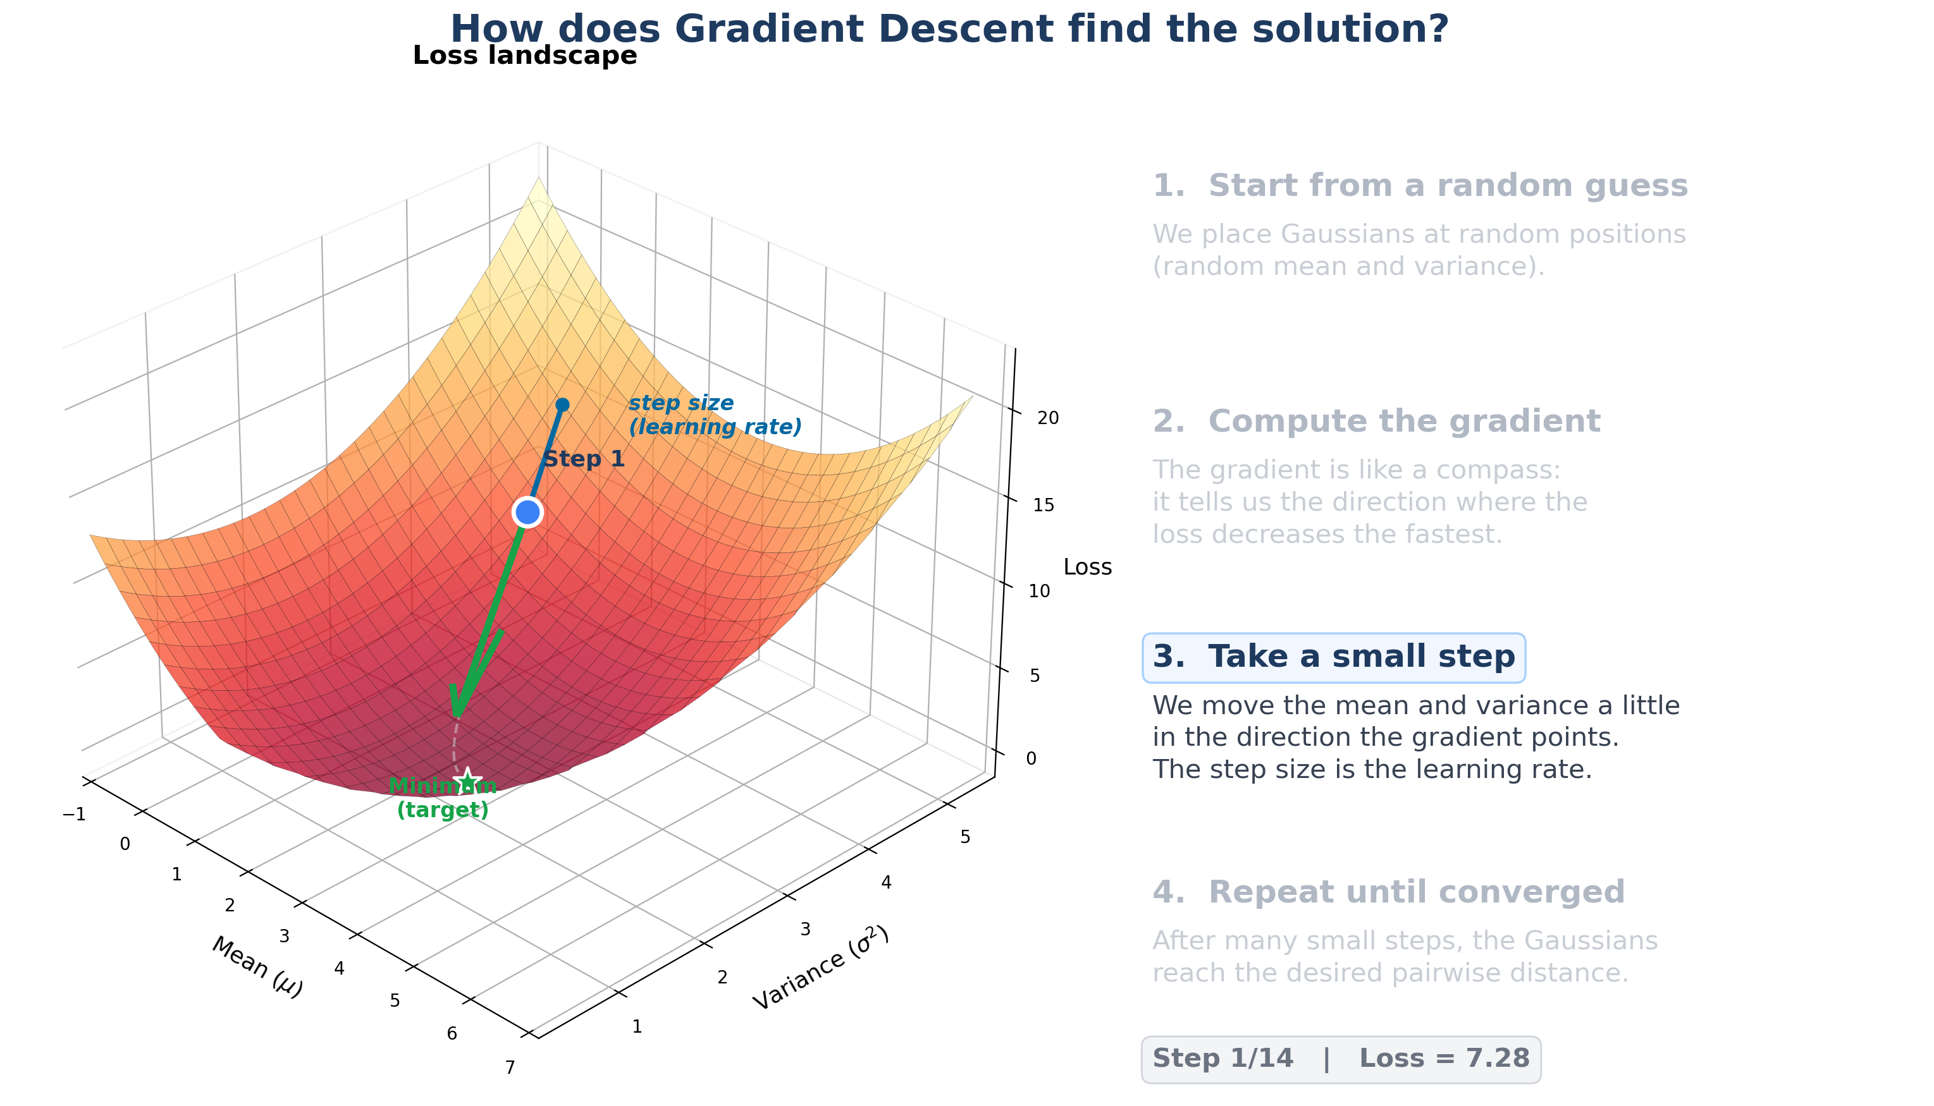

Slide 25
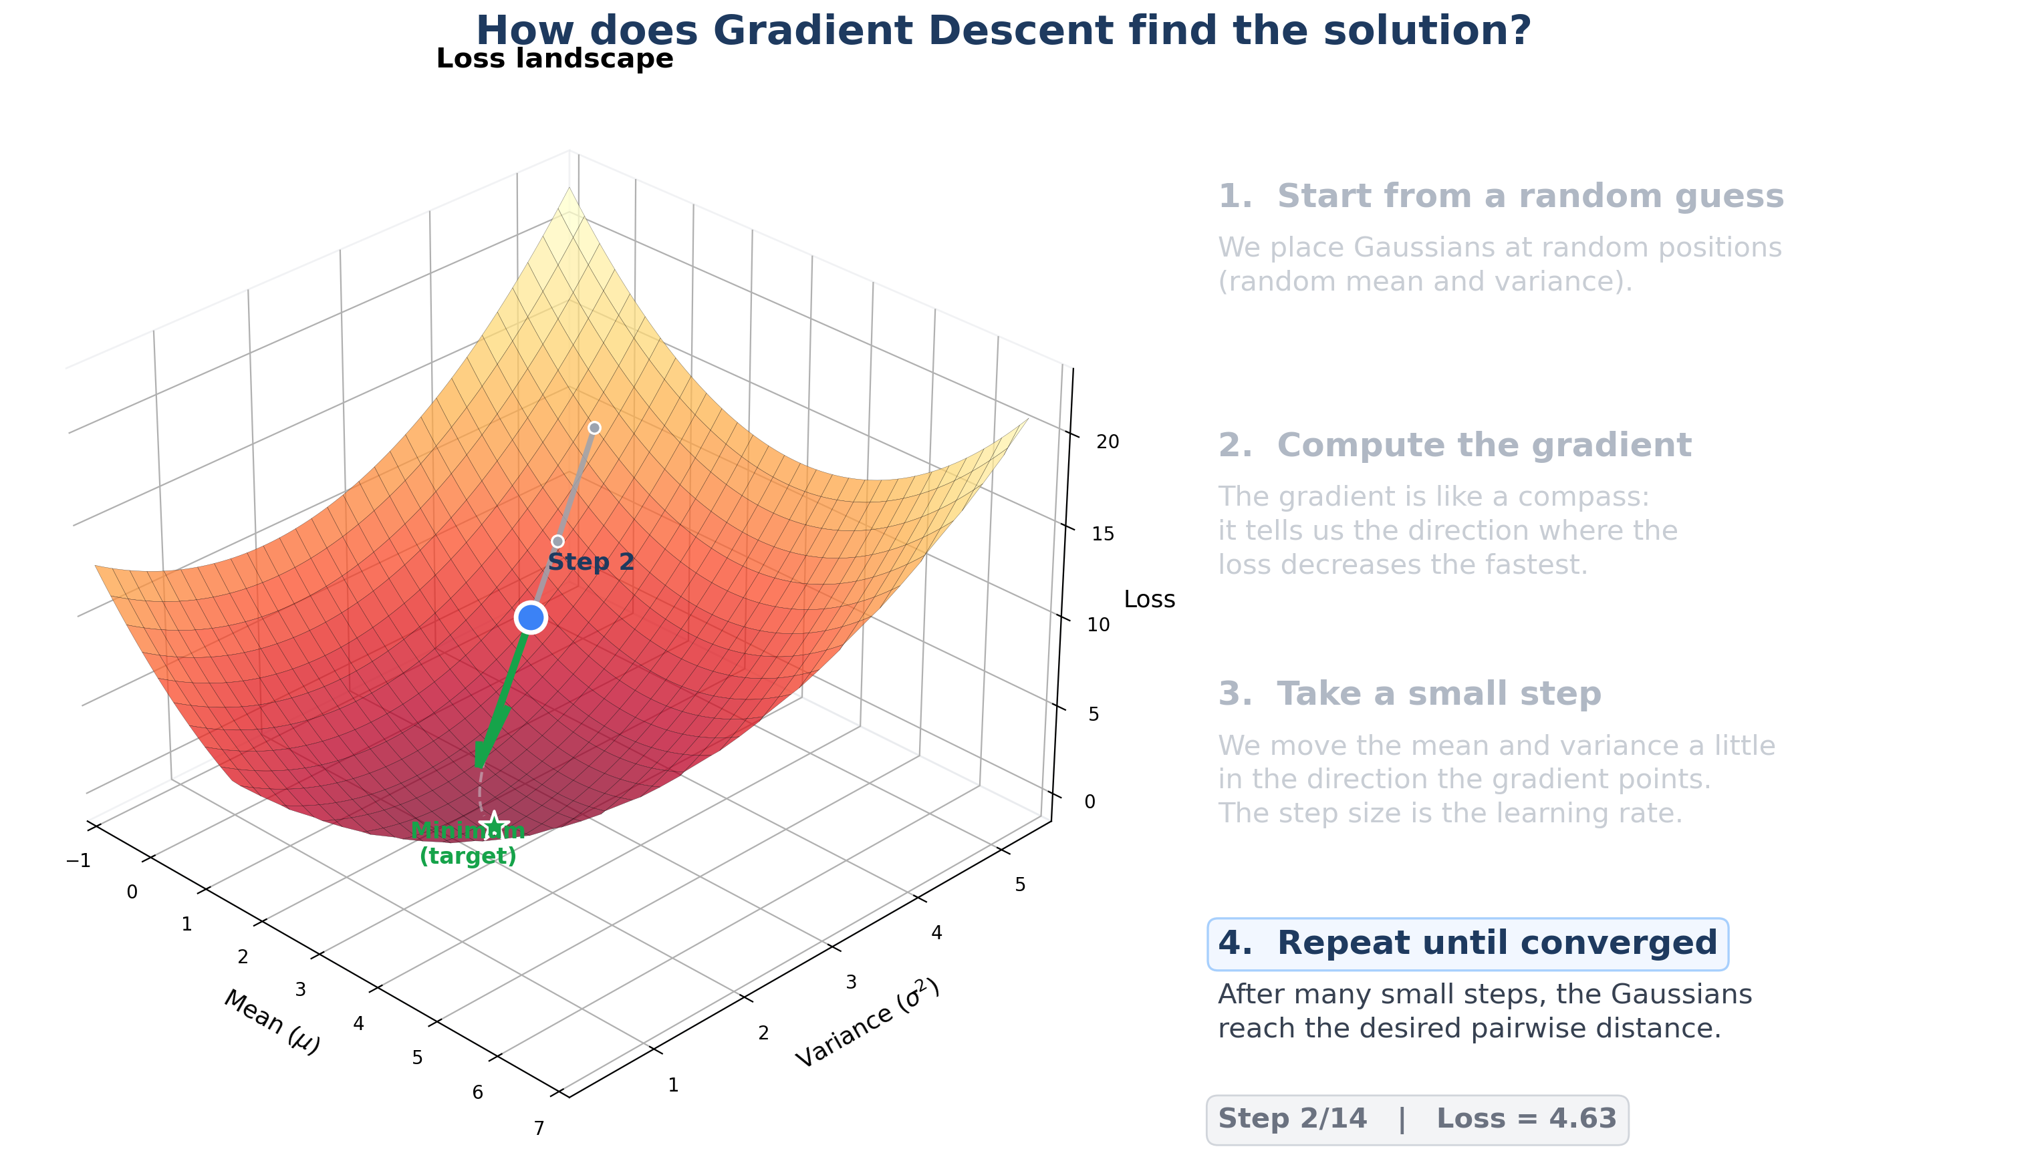

Slide 26


Slide 27


Slide 28


Slide 29
Vision of the whole Prj
Seen from environment persepctive

Slide 30
Idea:
Like Mengyao did use different sKL and different train frequency and see how the algorithm react in mean to those condition (which accumulates more regrets etc...
What I expect is something close to the slides below:
(this should be presented by every component (Luigi, Mengyao and Ale using their algorithm. Better to have same realizations to have a fair testing):

Slide 31
EXPERIMENTAL STORY
Where each algorithm wins
Regret ratio CUCB+CDT / Primal-dual across the (f, sKL) plane
high
COLOR ENCODING
REQ 4
REQ 3
regret ratio CUCB+CDT / Primal-dual
CDT wins
Primal-dual wins
CDT wins
tie
Primal-dual wins
Bottom band (low sKL)
sKL between regimes
Drift is undetectable by anyone. Both methods perform similarly — Req 2 territory.
Top-left (low f, high sKL)
Long stable regimes between sharp changes. CDT detects and adapts — clean Req 4 win.
REQ 2
stationary
Top-right (high f, high sKL)
low
Switches before any window can adapt. Primal-dual's worst-case guarantee shines — Req 3.
low
high
switching frequency f
The transition diagonal
Where one method overtakes the other. The most informative part of the plot.
One plot tells the whole story: the regime where best-of-both-worlds guarantees actually pay off.

Slide 32
EXPERIMENTAL STORY
Where each algorithm wins
Regret ratio CUCB+CDT / Primal-dual across the (f, sKL) plane
high
COLOR ENCODING
REQ 4
REQ 3
regret ratio CUCB+CDT / Primal-dual
CDT wins
Primal-dual wins
CDT wins
tie
Primal-dual wins
Bottom band (low sKL)
sKL between regimes
Drift is undetectable by anyone. Both methods perform similarly — Req 2 territory.
I suppose here will win REQ 2 project.
Top-left (low f, high sKL)
Long stable regimes between sharp changes. CDT detects and adapts — clean Req 4 win.
REQ 2
stationary
Top-right (high f, high sKL)
low
Switches before any window can adapt. Primal-dual's worst-case guarantee shines — Req 3.
low
high
switching frequency f
The transition diagonal
Where one method overtakes the other. The most informative part of the plot.
One plot tells the whole story: the regime where best-of-both-worlds guarantees actually pay off.

Slide 33
Future work…
Analyze behaviour with non sudden changes
Recurring state of the market

Slide 34
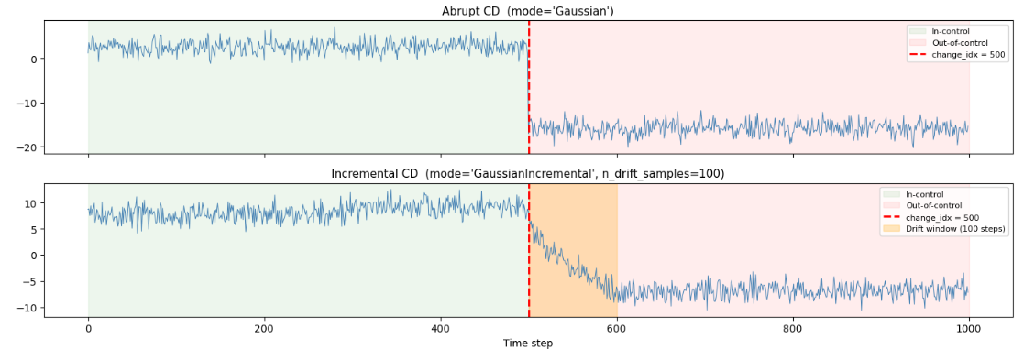
Incremental CD
Tested to make sure that:
Transition is monotone → if μ1≤ μT then μ1≤μ2≤… μT
ΔSKL is the same amongst every sample

Slide 35
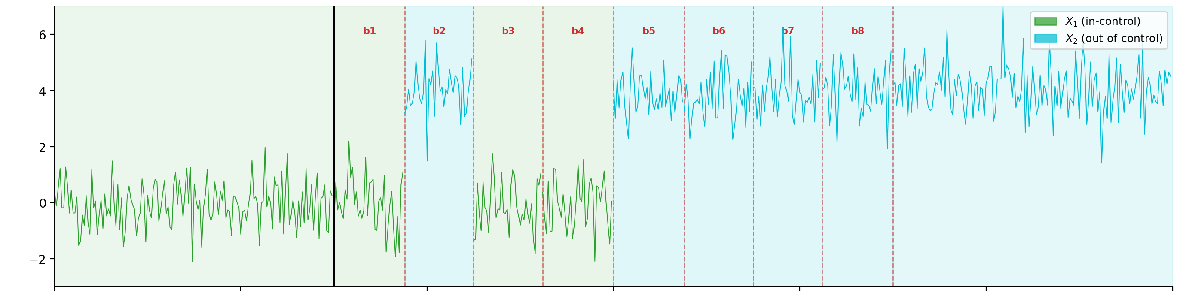
Gradual CD
3 distinct phase:
In control phase: where just φ0 is present
Transition phase: where φ0 and φ1 alternates (for each block bi a distribution is sorted)
Out of control phase: where just φ1 is present

Slide 36
Recurring state of the market
In normal case scenario we know that seasonality impose recurring states. Our environment of gaussian constellation adapts very well that case. Useful tests so could be to implement something like Learn++.NSE to have multiple models and updates their weights of importance when the environment that would require that eventually comes up again.
References
Elwell, R., & Polikar, R. (2011). Incremental Learning of Concept Drift in Nonstationary Environments. IEEE Transactions on Neural Networks, 22(10), 1517–1531. https://doi.org/10.1109/tnn.2011.2160459 Cited by: 1230

Slide 37
CCM + Rejection sampling
Analysis of the previous methods used and accepted in literature

Slide 38
Previous work: CCM + Rejection sampling
Baseline based on previous literature:
while Generated_Gaussians < M :
1. Use CCM (explained on slide 59) to find a new candidate Gaussian φ_{N} at a given SKL from φ₀
2. Check if all pairwise constraints are satisfied:
if SKL_{min} ≤ SKL(φ_{N}, φ_{i}) ≤ SKL_{max} ∀i :
Accept φ_{N} into the constellation
else :
Reject φ_{N} and retry
References:
Generating High-Dimensional Datastreams for Change Detection D. Carrera, G. Boracchi
Multimodal Batch-wise Change Detection D. Stucchi, G. Boracchi, L. Magri, D. Carrera*
*Note: this paper imposed just a lower bound on the SKL divergence.

Slide 39
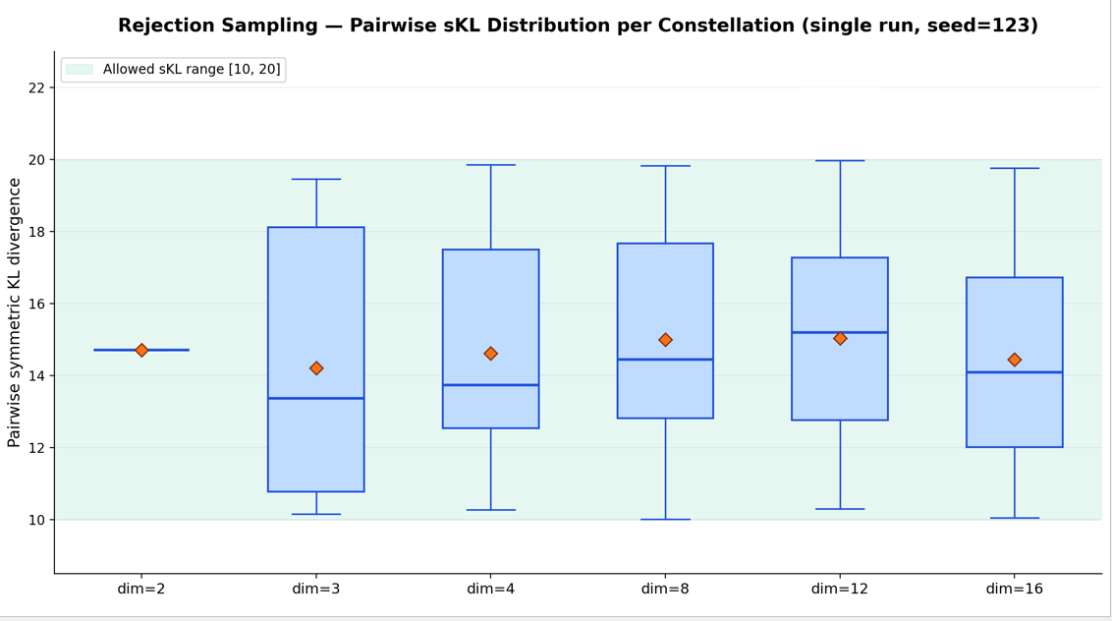

Slide 40
Whisker plots are bounded.

Slide 41
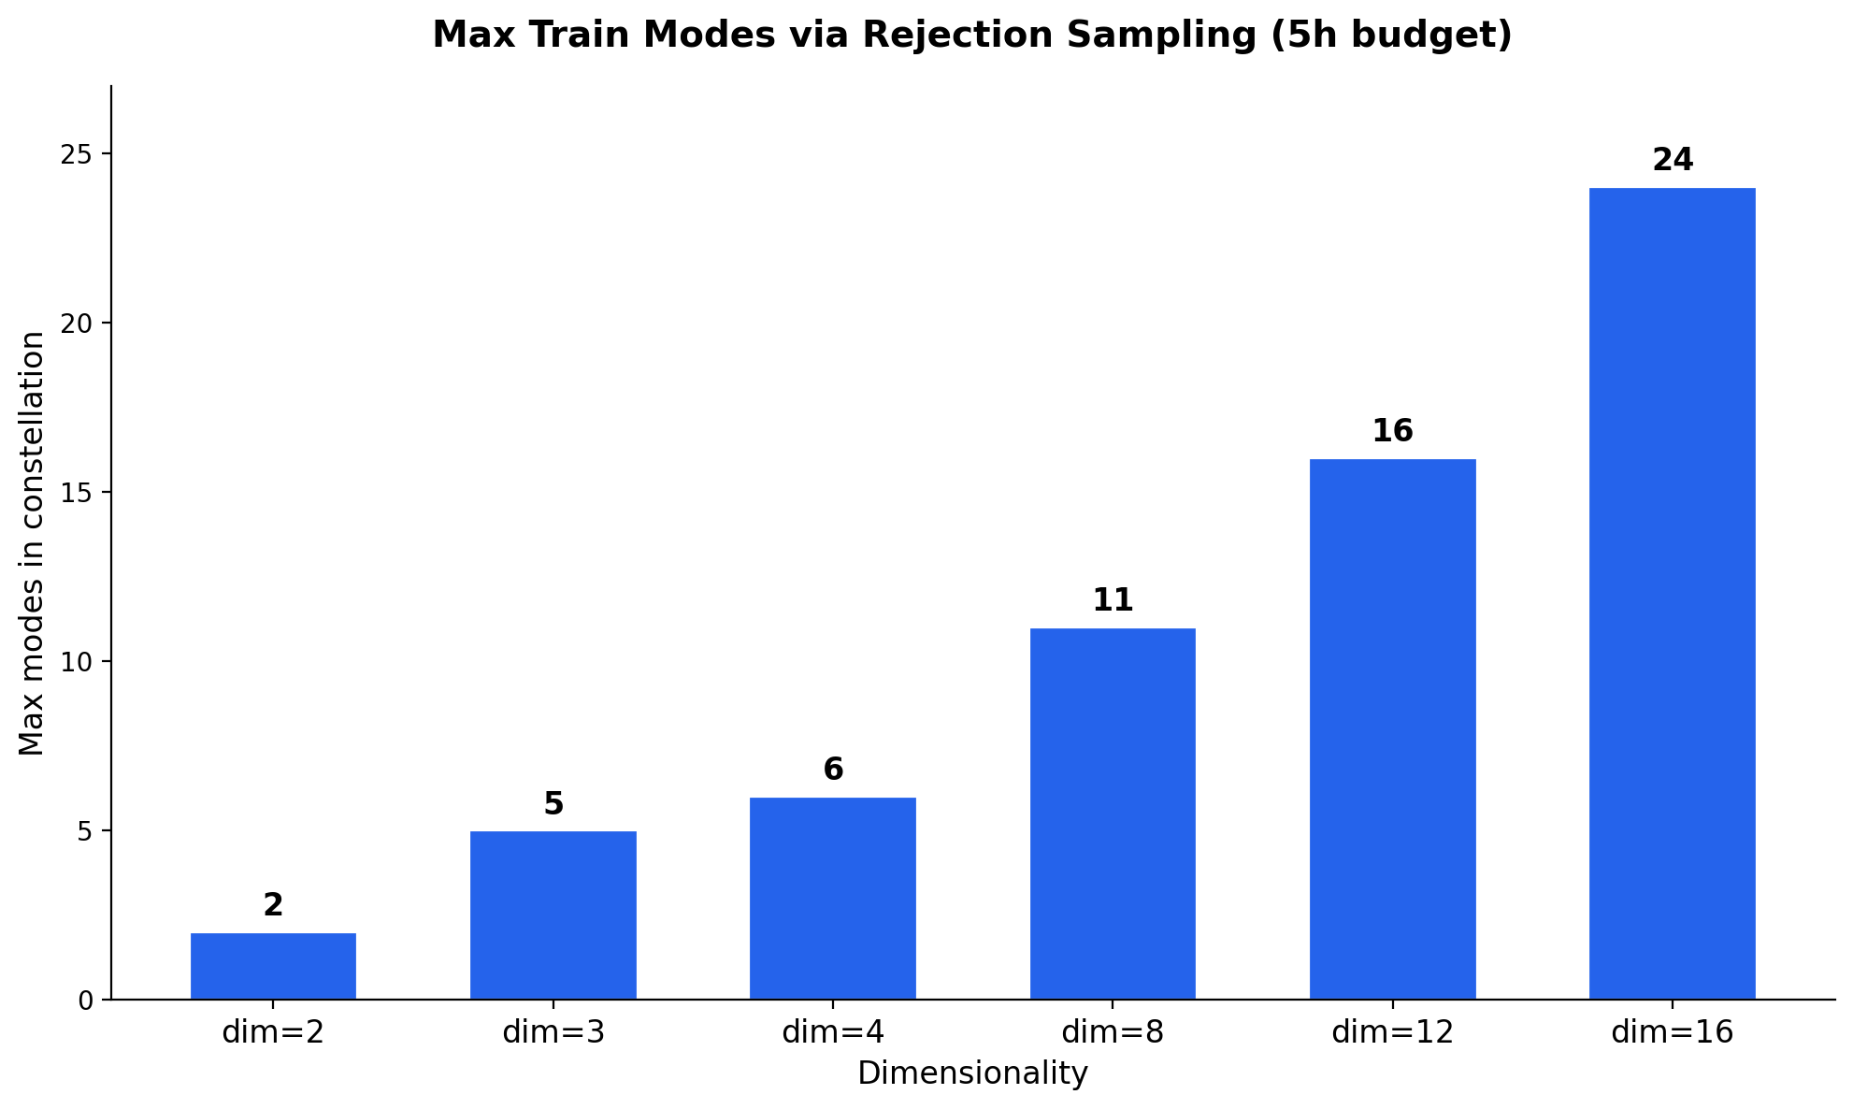

Slide 42
⚠️
For lower dimension the in-train modes can be too few.
We do not have any guarantee on when the algorithm will terminate.

Slide 43
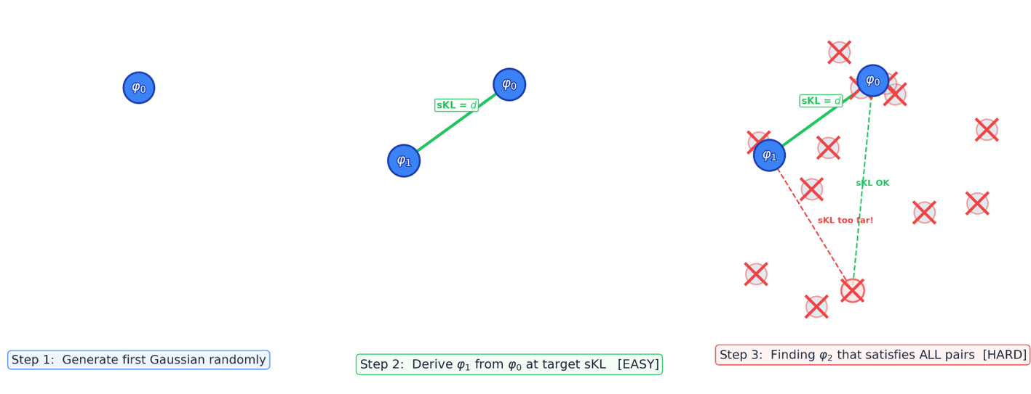
CCM + Rejection Sampling (Visuals)

Slide 44
Benchmark comparison
OGD VS rejection sampling

Slide 45
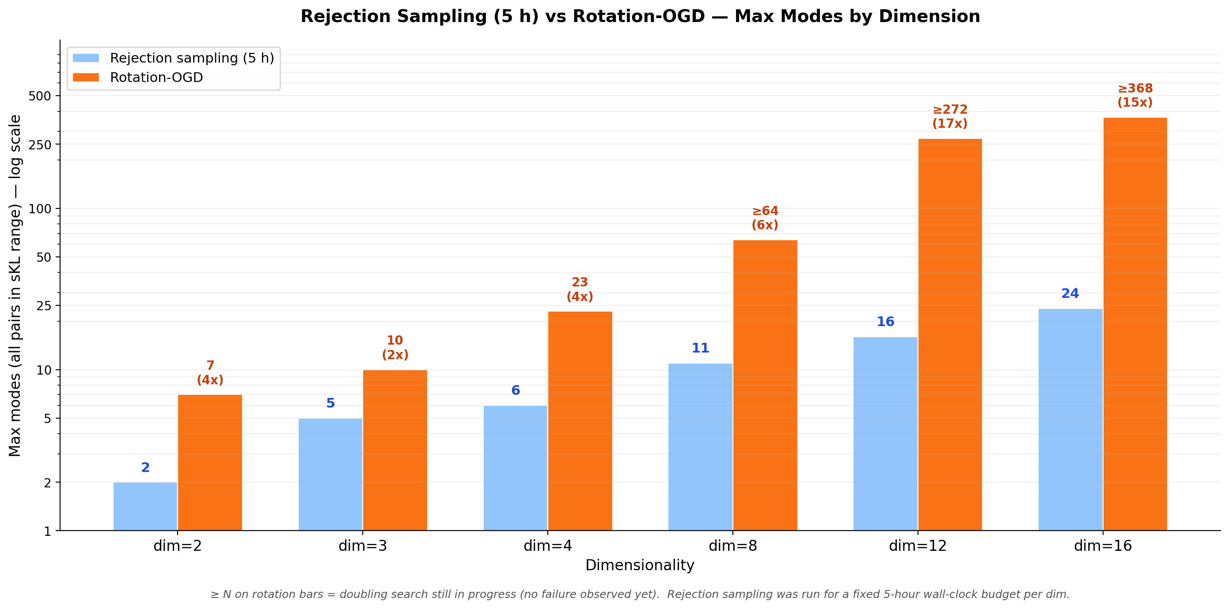

Slide 46
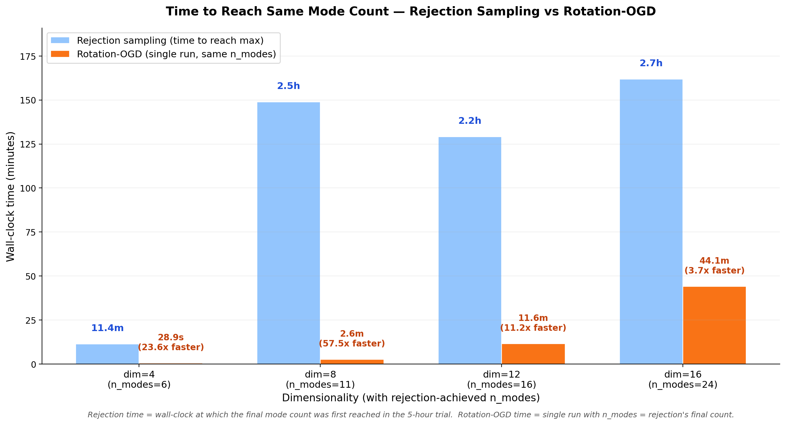

Slide 47
Geometric explaination of why OGD is better than rej sampling.
Based on an easy and reppresentable 2d example

Slide 48
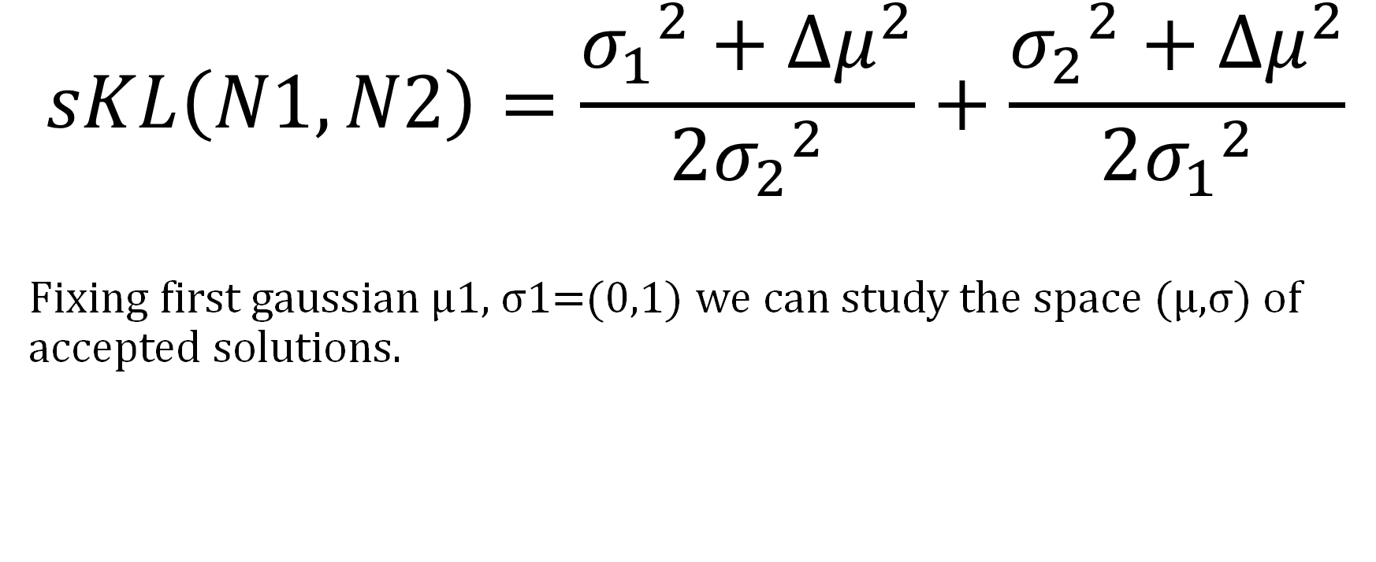
SKL closed form for 1D Gaussians
$$sKL\left(N1,N2\right)=\frac{{σ_{1}}^{2}+Δμ^{2}}{2{σ_{2}}^{2}}+\frac{{σ_{2}}^{2}+Δμ^{2}}{2{σ_{1}}^{2}}$$
Fixing first gaussian μ1, σ1=(0,1) we can study the space (μ,σ) of accepted solutions.

Slide 49
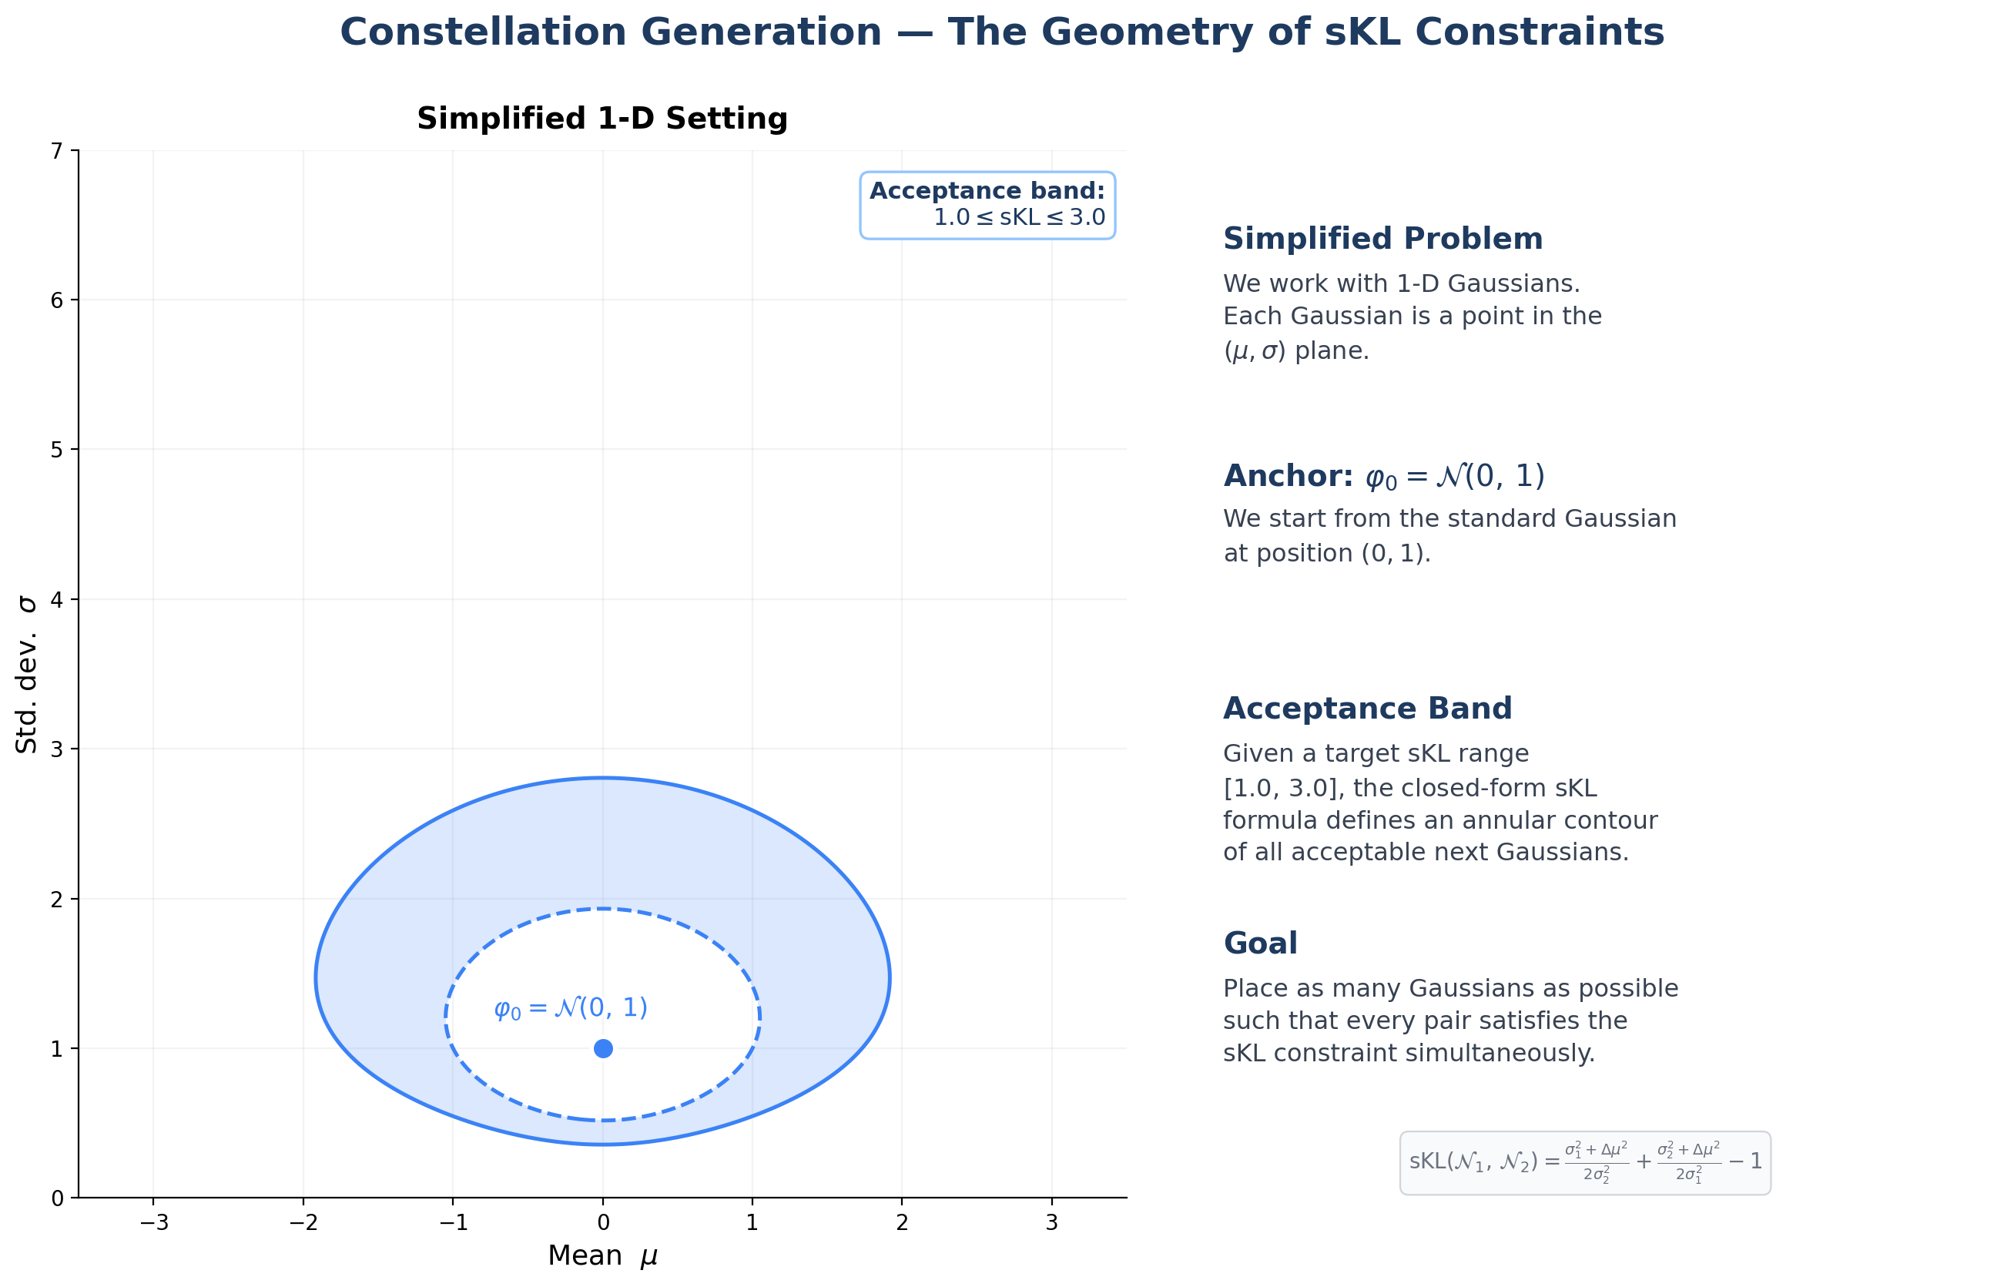

Slide 50
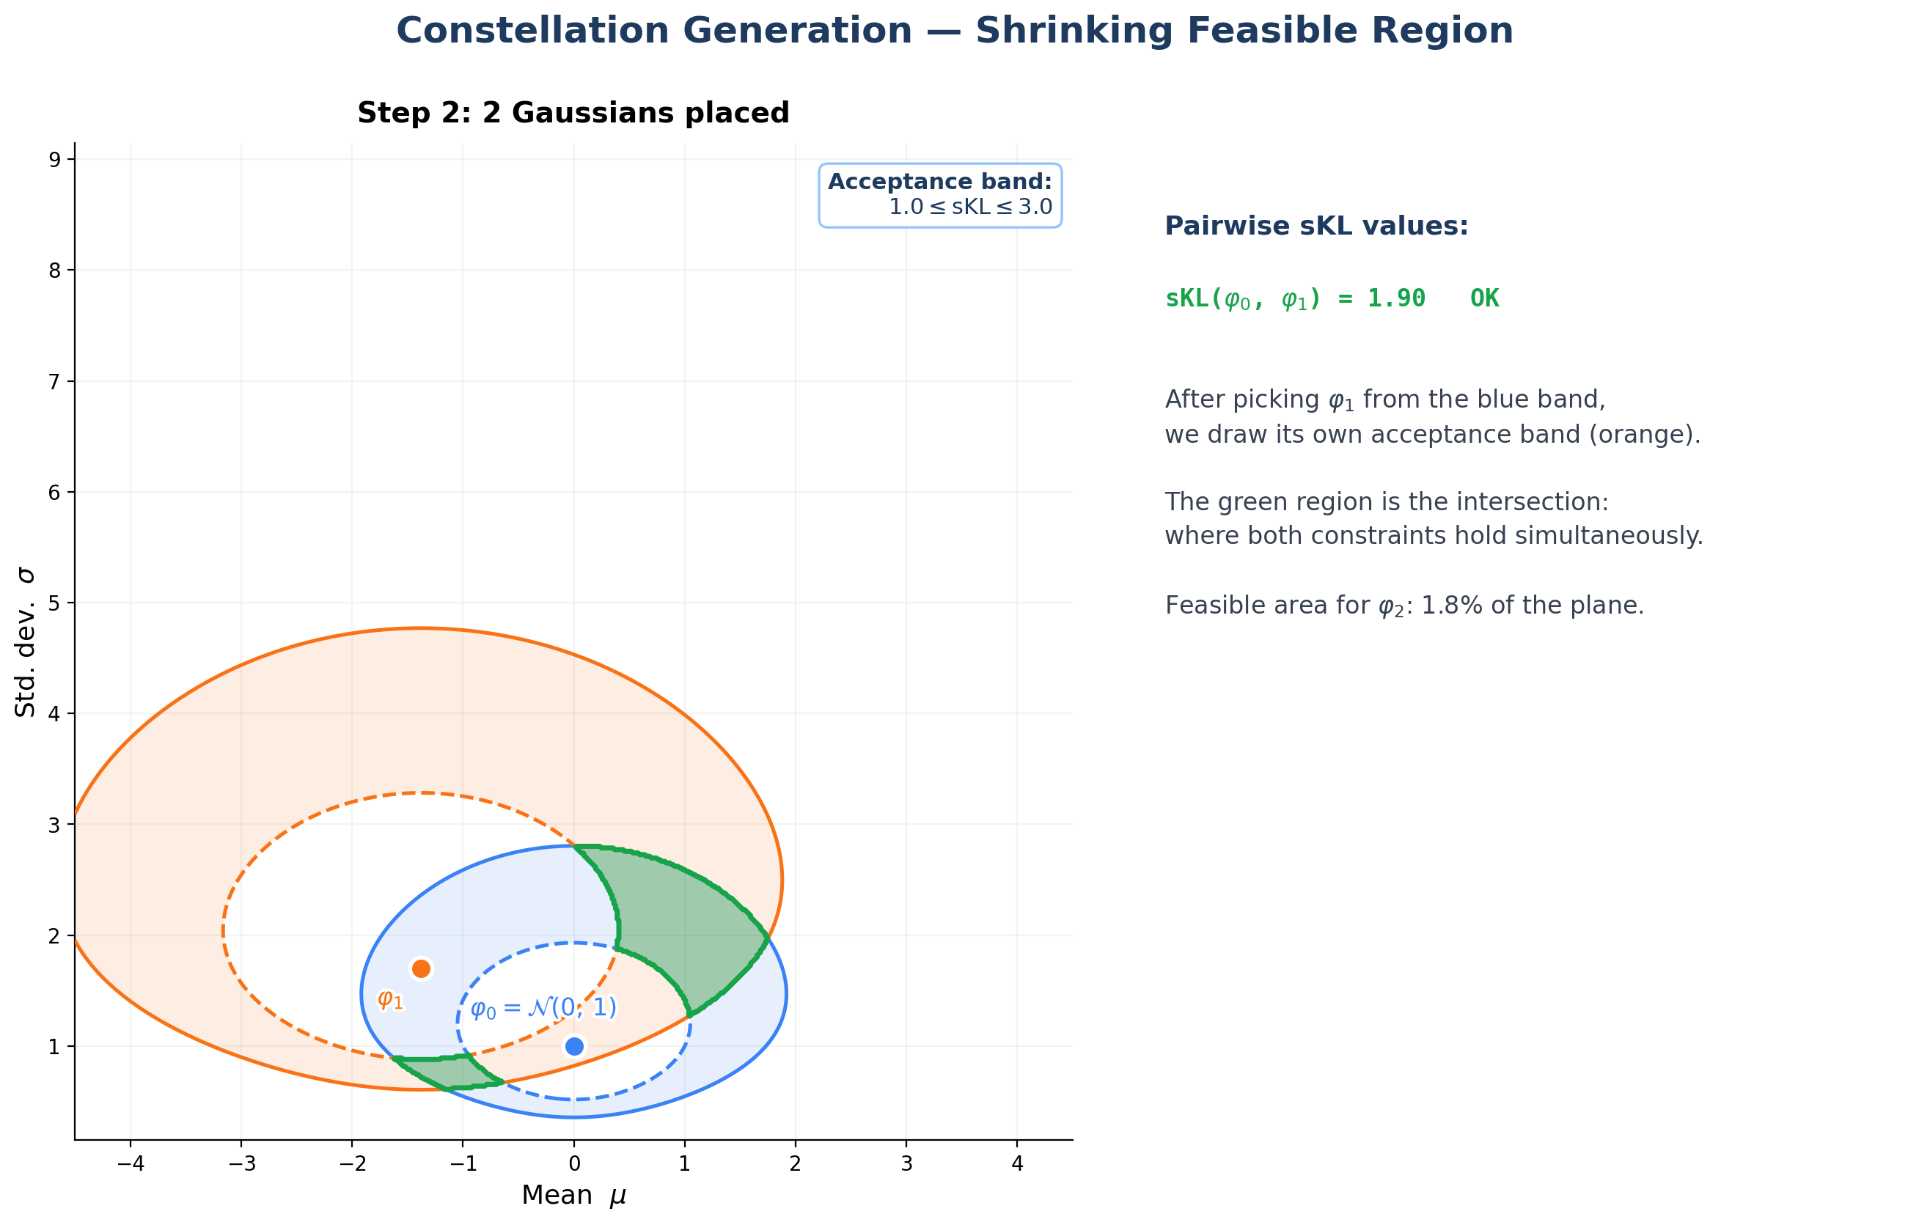

Slide 51
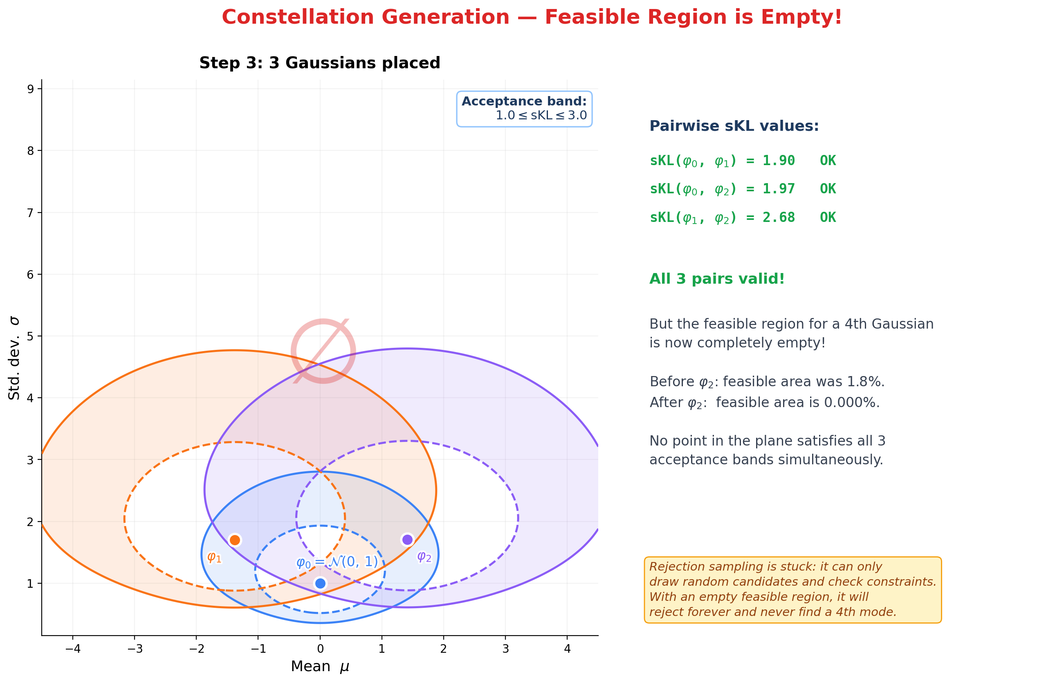

Slide 52
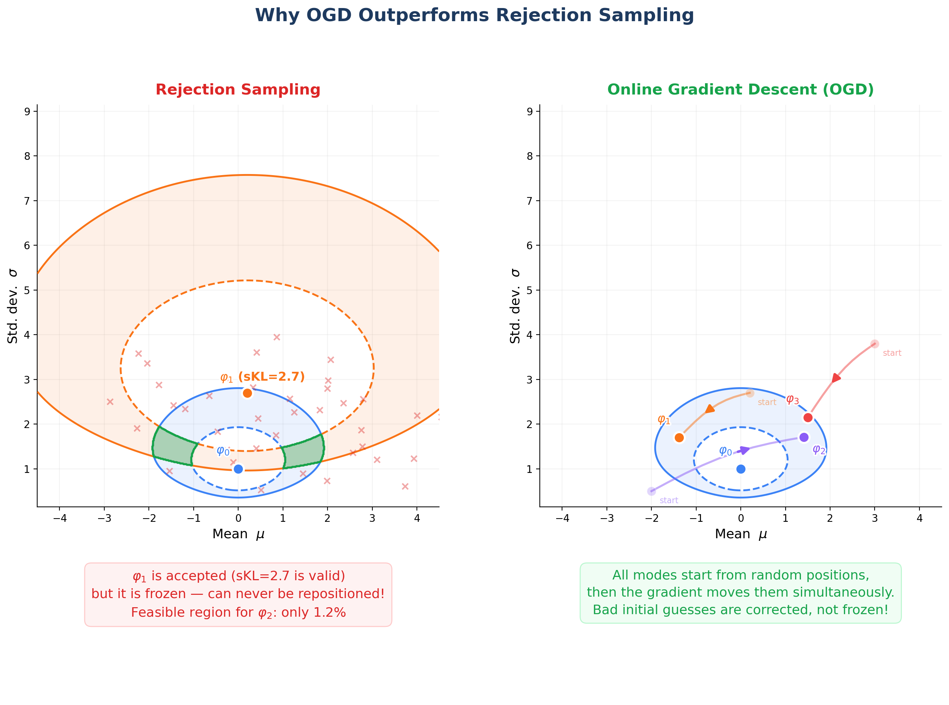

Slide 53
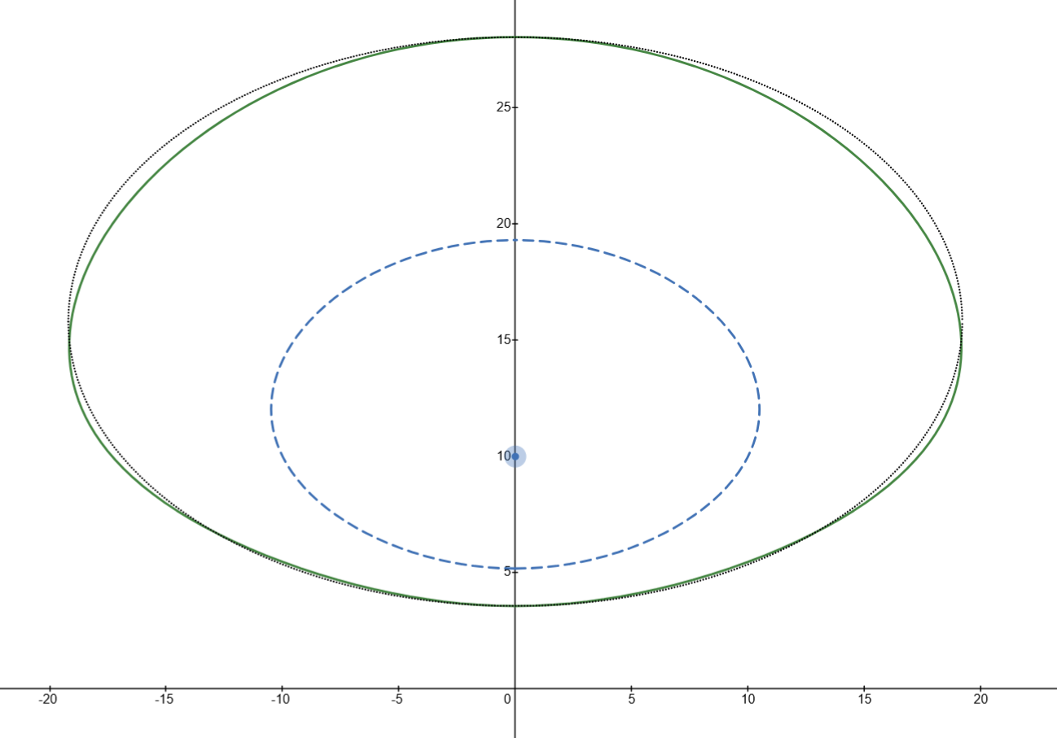
To see accepted space with the change of μ, σ:
https://www.desmos.com/calculator/hudl929q3m

Slide 54
This asymmetric form depends on the distinguishability of the variance…

Slide 55
Last Considerations
OGD VS Rej Sampling

Slide 56
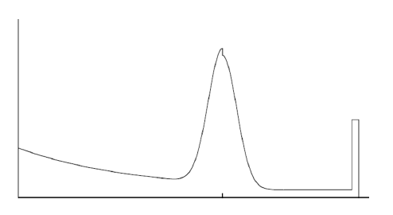
Known limitations: Strange distributions
This method relies on the closed formula of the SKL.
For many known distributions there exists a closed formula (Gaussian (Normal) Bernoulli/Binomial, Gamma, Beta, Poisson, Exponential etc...).
Unfortunately there exists distributions for which a closed formula doesn't exists (t-student, GMM, combination of multiple gaussian + exponential etc...).
Beam sensor model from: Probabilistic Robotics

Slide 57
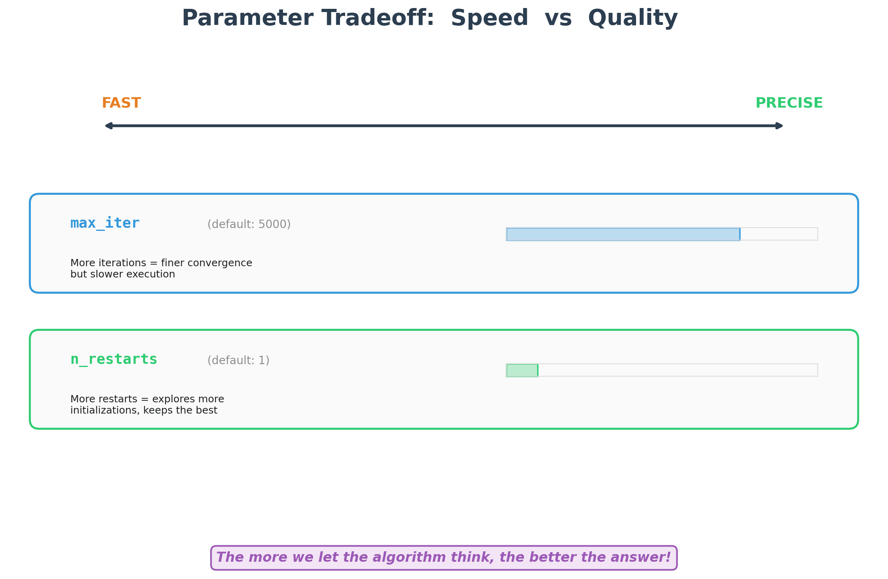
To know more→ Hyper-param tuning→ Extra materials

Slide 58
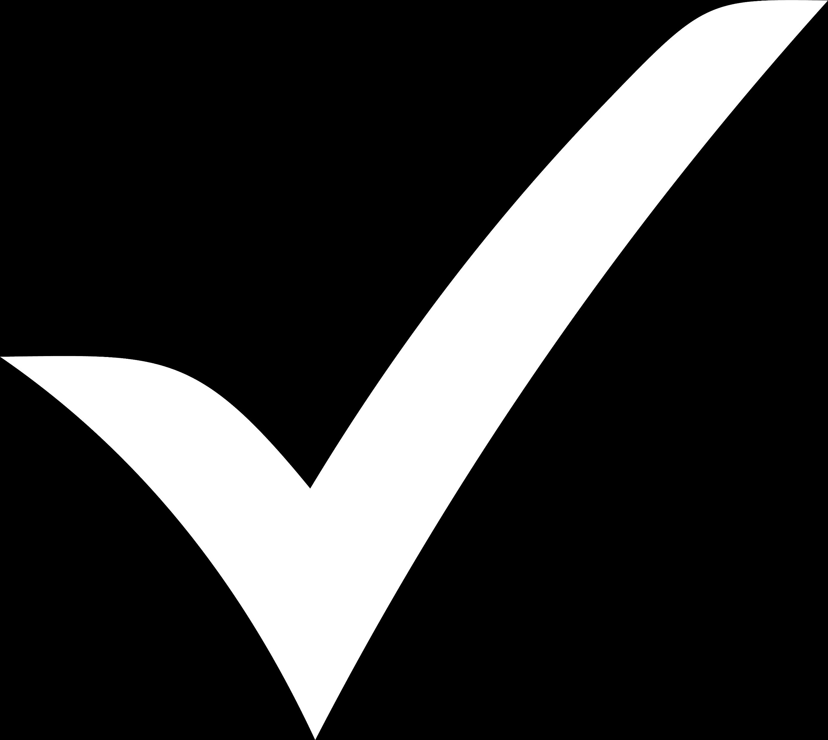
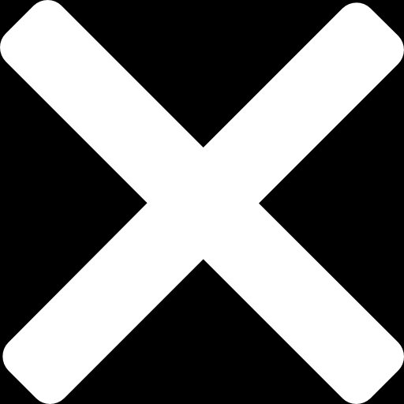
OGD VS Rej sampling
Pros
Cons
Faster
Explainability
Better performance: More in train modes. Support precise version.
Every optimization step is: O(N² d³)
Soft fail: Always converge to best solution found.
Can be outperformed for easy tasks
(high d low in train modes, generous sKL bounds)
Settable Time VS Accuracy tradeoff.
Requires a closed formula for sKL.
?
*The "?" means possible extensions could deal with the cons.

Slide 59
How CCM works?
How can we generate N multivariate gaussians with the same SKL?

Slide 60
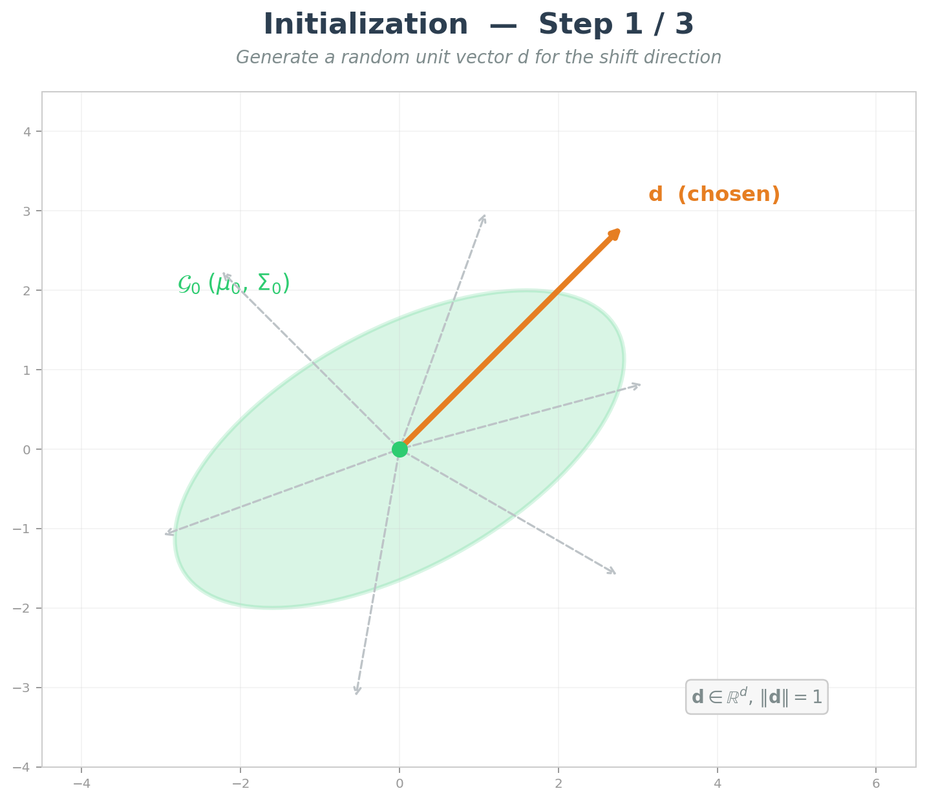
Randomly chose a direction d where to move the mean of the gaussian

Slide 61
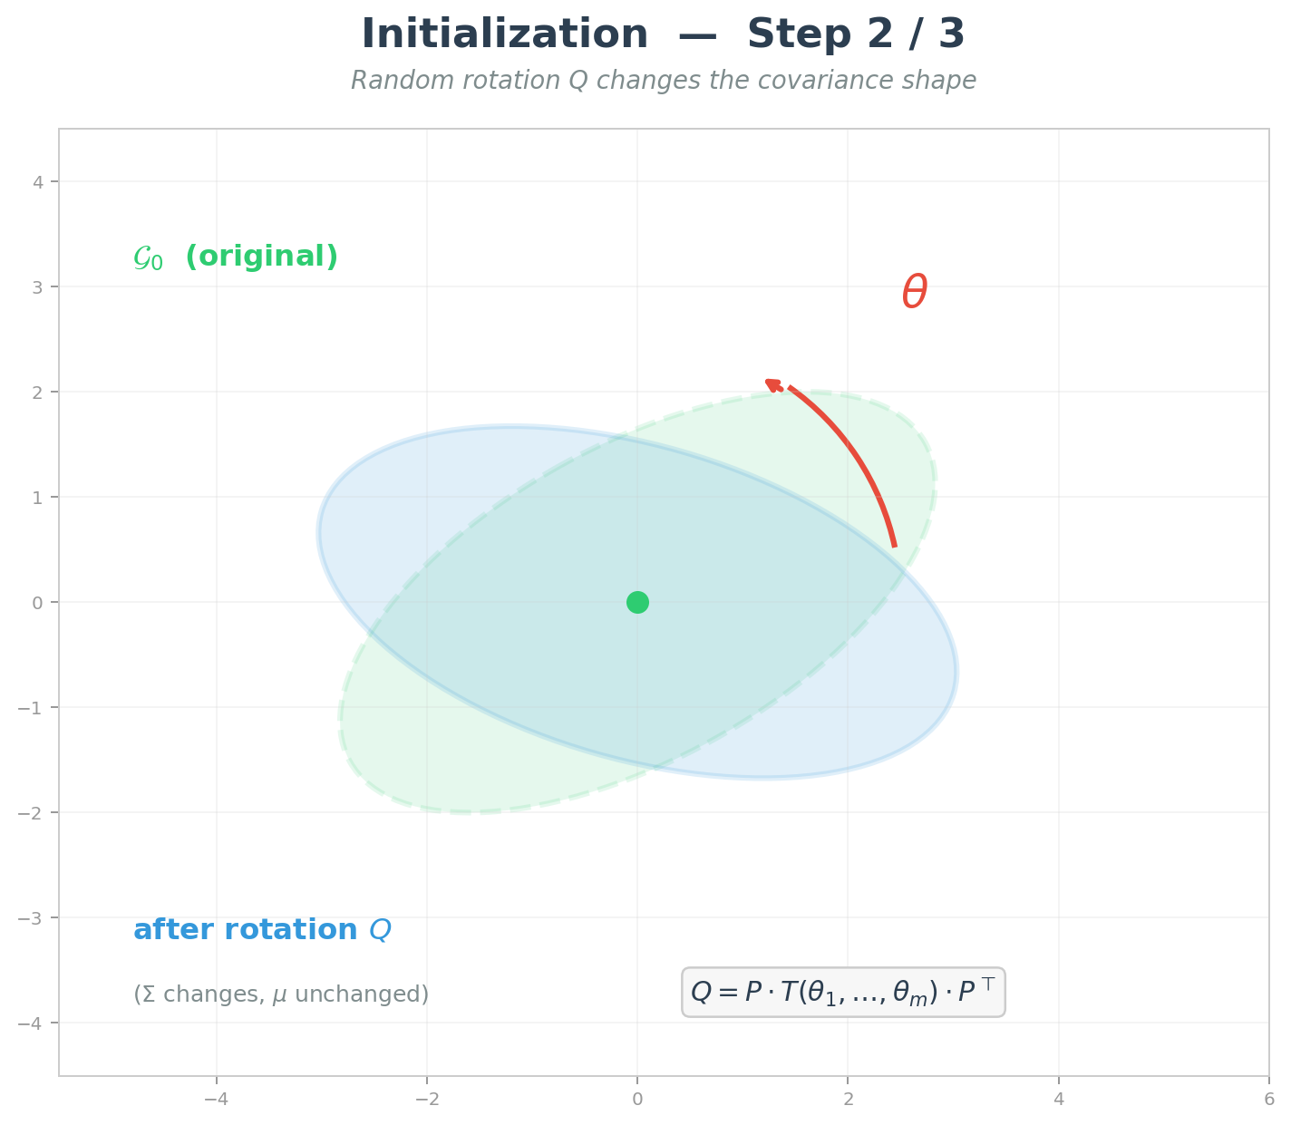
Randomly chose rotation angles ϑ to change also the covariance matrix

Slide 62
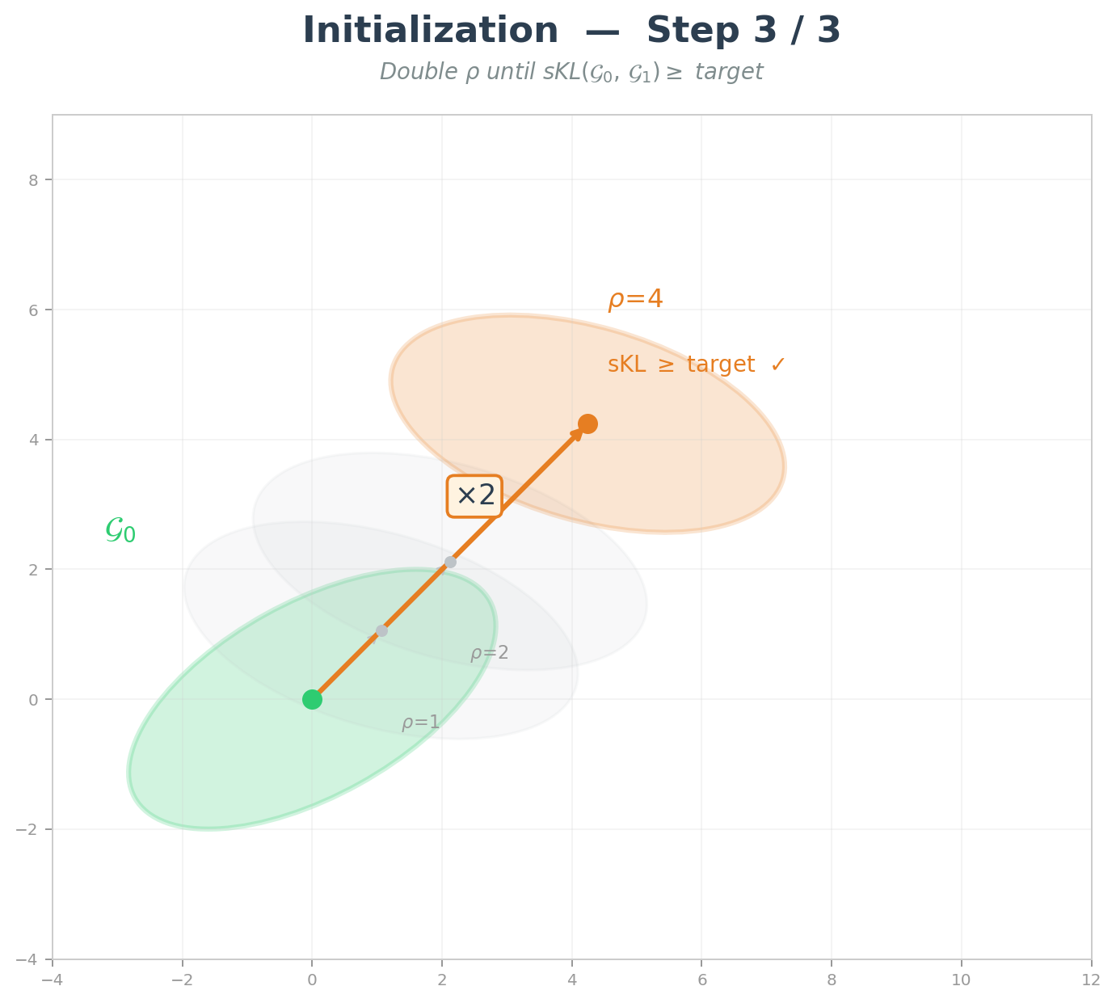
Move the rotated gaussian doubling each time ρd, the distance in the direction chosen until we get a SKL0 which is higher than the target.

Slide 63
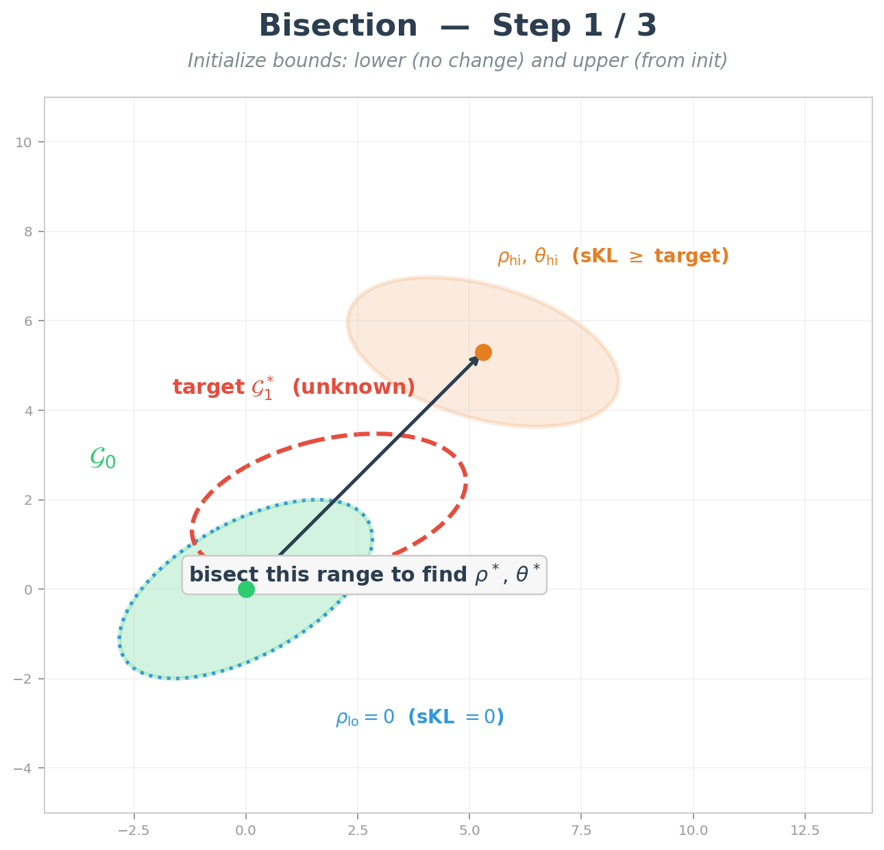
In this second step we will refine the gaussian we found which has a SKL0(φ0,φN)≥SKLtarget finding a gaussian «in between» φ0 and φN

Slide 64
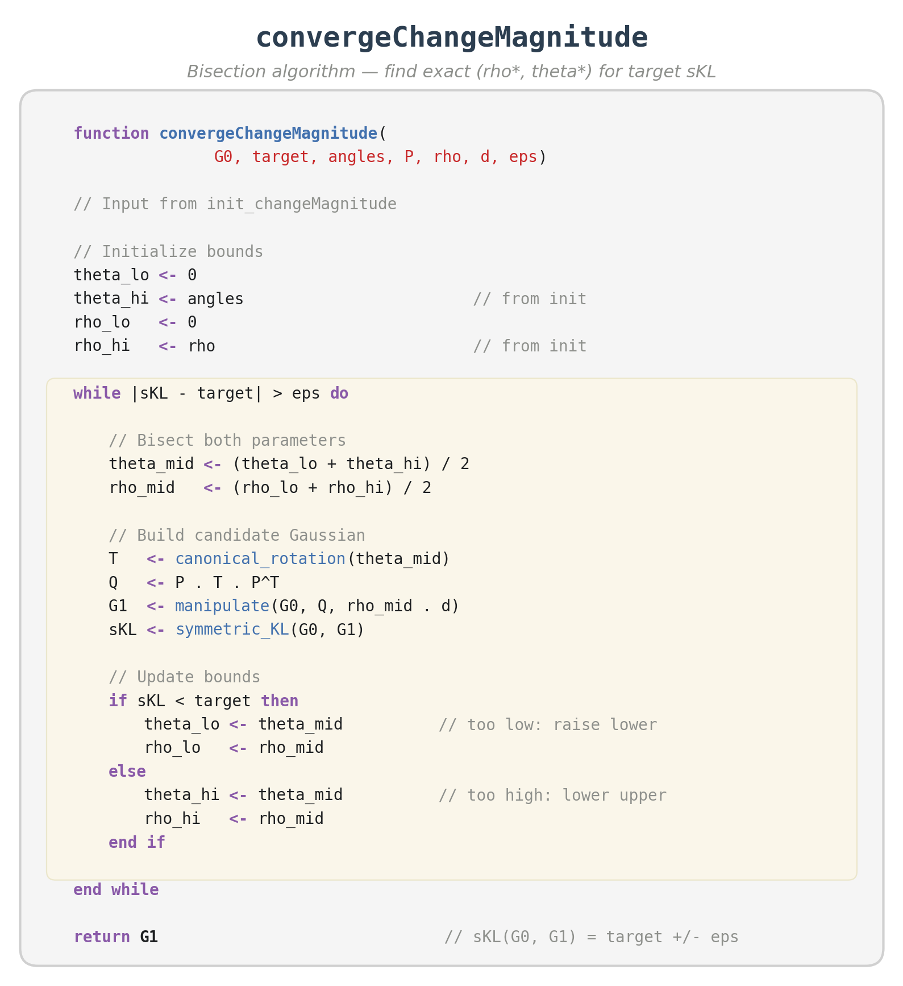
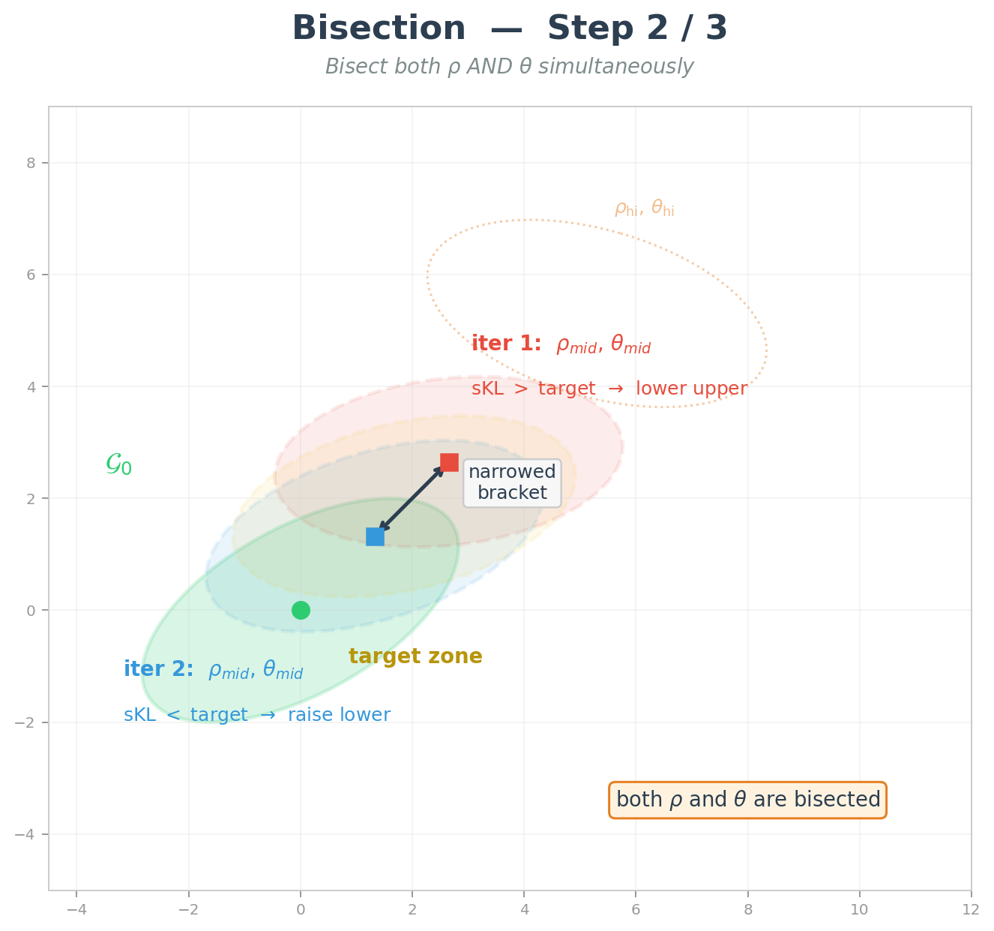

Slide 65
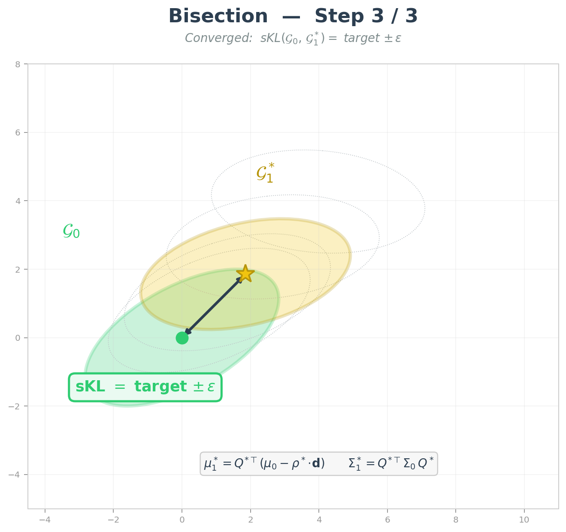
… Until convergence

Slide 66
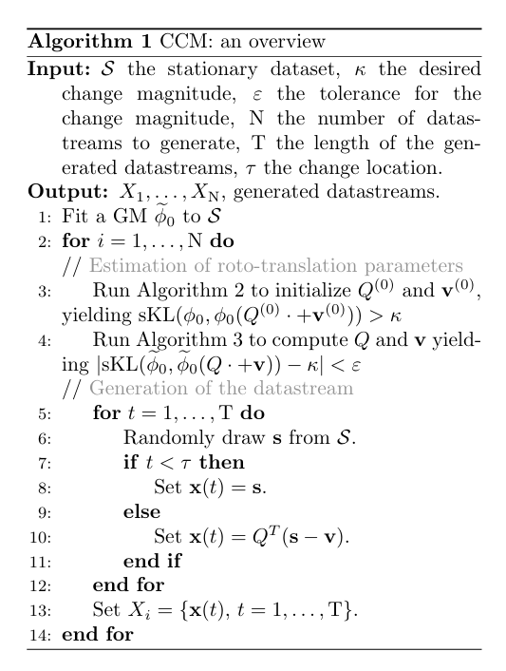

Slide 67
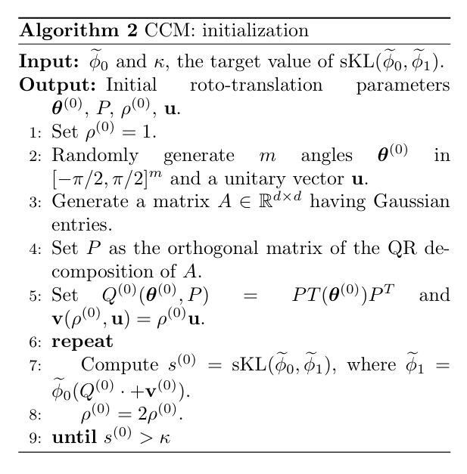

Slide 68
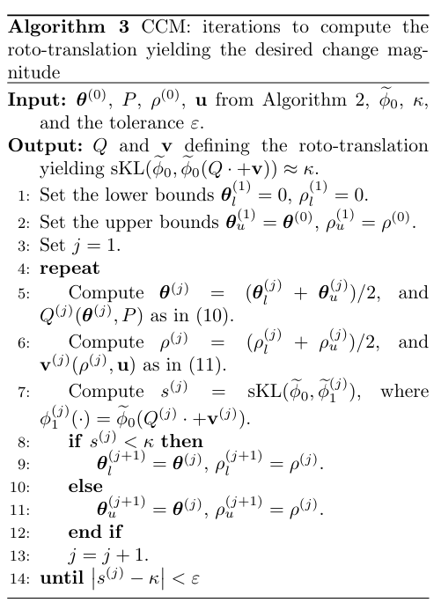

Slide 69
Derivations of sKL gradient from MSE

Slide 70
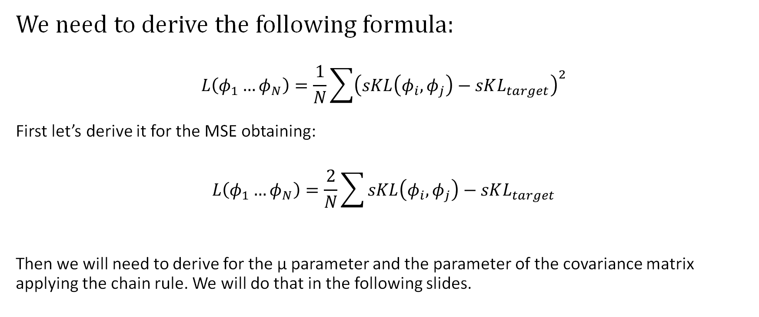
Derivations
We need to derive the following formula:
$$L\left(φ_{1}…φ_{N}\right)=\frac{1}{N}\sum{{\left(sKL\left(φ_{i},φ_{j}\right)−sKL_{target}\right)}^{2}}$$
First let’s derive it for the MSE obtaining:
$$L\left(φ_{1}…φ_{N}\right)=\frac{2}{N}\sum{sKL\left(φ_{i},φ_{j}\right)−sKL_{target}}$$
Then we will need to derive for the μ parameter and the parameter of the covariance matrix applying the chain rule. We will do that in the following slides.

Slide 71
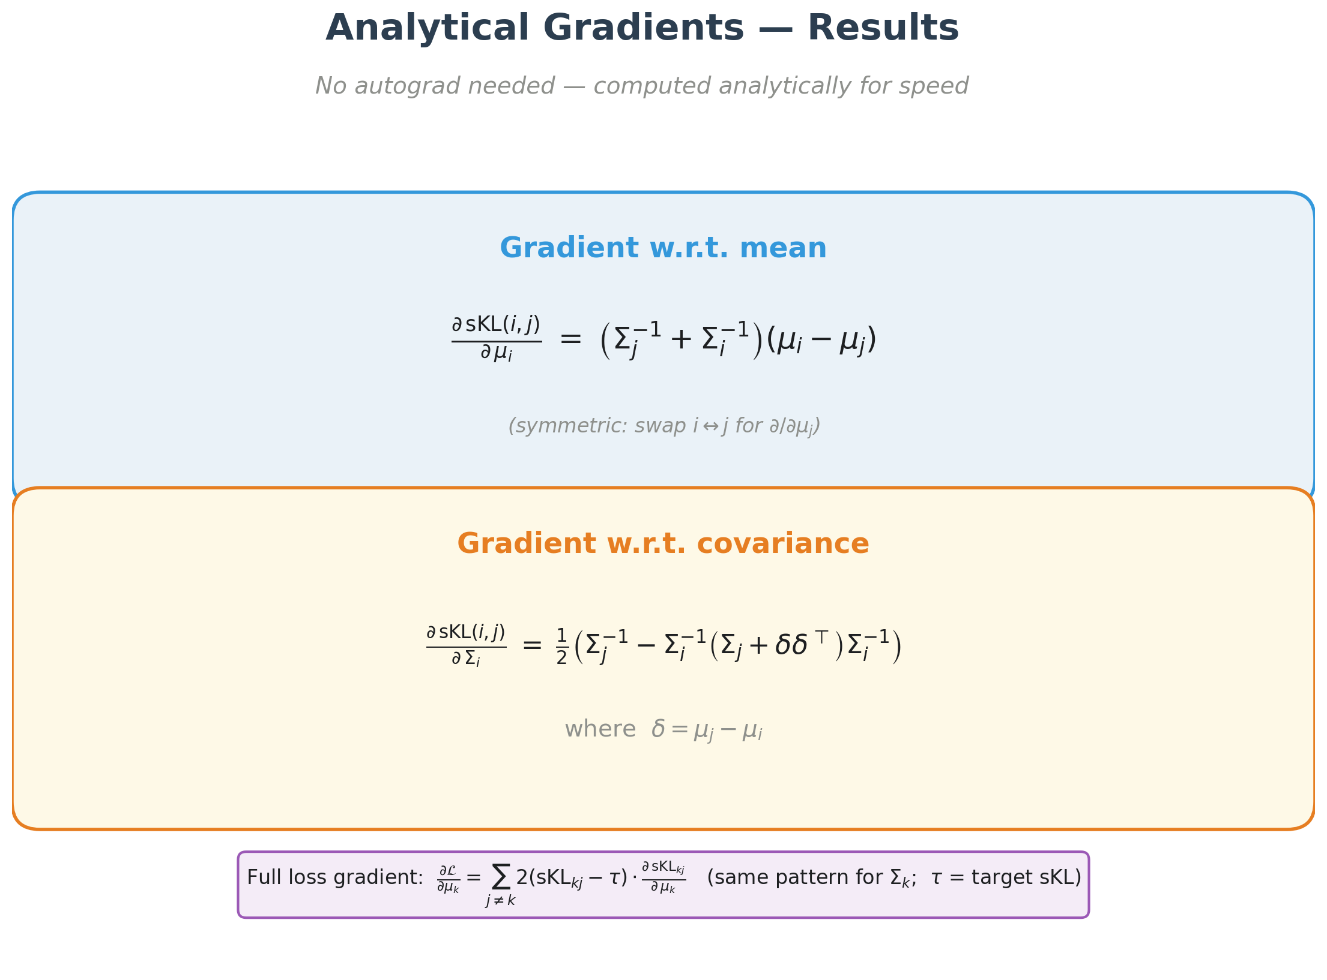

Slide 72

Note here that Σi and Σj are the previous ones.

Slide 73

and noting how:
- Σ=Σ^{T}
- ln|Σj/Σi|=ln|Σj|-ln|Σi|

Slide 74


Slide 75


Slide 76


Slide 77
Rotation OGD
Based on parametrizing the covariance of all the gaussian find as a rototranslation of a fixed anchor φ0, in formula:
Σi= Q(ϑ)^{T} Σ0 Q(ϑ)

Slide 78


Slide 79
Why imposing just rotation make setting harder?
Using a rotation of the covariance matrix makes inefficient tests that do not consider all the metrics together.

Slide 80
Hyper-parameter tuning

Slide 81
Summary
max_iter: absolute bound in term of number of iteration. I would suggest to leave this parameter high because patience will stop the execution well before.
patience: if we do not improve on loss after patience iter we will stop. With this setting if a solution is founded we will immediately stop and lets us set max_iter parameter a little bit more losely
n_restart: if we are interested in a particular solution and we have plenty of time we could try to see if increasing this parameter will increase slightly the solution. It is particularly helpful in lower dimensions were convergence time is very low.
lr: I tried different learning rates but usually they won’t make much of a difference. ADAM handles this hyper parameter tuning so most of the time this can be left to default.

Slide 82


Slide 83
Extra: Finding closed formula for 1d sKL gaussian
Finding KL(N1,N2)
Finding SKL(N1,N2)

Slide 84

https://stats.stackexchange.com/questions/7440/kl-divergence-between-two-univariate-gaussians

Slide 85
From KL to sKL — Gaussian case
p = N(μ₁, σ₁), q = N(μ₂, σ₂), Δμ = μ₁ − μ₂
1
KL divergence (Gaussian)
KL(p, q) = log(σ₂ ⁄ σ₁) + (σ₁² + Δμ²) ⁄ (2σ₂²) − 1⁄2
2
Symmetrize: sKL = KL(p,q) + KL(q,p)
sKL(p, q) = log(σ₂ ⁄ σ₁) + log(σ₁ ⁄ σ₂) + (σ₁² + Δμ²) ⁄ (2σ₂²) + (σ₂² + Δμ²) ⁄ (2σ₁²) − 1
3
Logs cancel: log(σ₂ ⁄ σ₁) + log(σ₁ ⁄ σ₂) = 0
sKL(p, q) = (σ₁² + Δμ²) ⁄ (2σ₂²) + (σ₂² + Δμ²) ⁄ (2σ₁²) − 1
4
Fix p = N(0, 1): σ₁ = 1, μ₁ = 0, so Δμ = −μ₂
sKL(μ, σ) = (1 + μ²) ⁄ (2σ²) + (σ² + μ²) ⁄ 2 − 1 where q = N(μ, σ)
Parametric level curve in (μ, σ): {(μ, σ) : sKL(μ, σ) = c}
sKL(μ, σ) = (1 + μ²) ⁄ (2σ²) + (σ² + μ²) ⁄ 2 − 1

Slide 86
Why using sKL instead of KL?

Slide 87
Understanding why using KL could be better
Stein’s lemma is based on the KL.
Stein’s lemma tells us together with Lourden works on CUSUM will point us to use directly to KL but…
https://projecteuclid.org/journals/annals-of-mathematical-statistics/volume-42/issue-6/Procedures-for-Reacting-to-a-Change-in-Distribution/10.1214/aoms/1177693055.full

Slide 88
Reason #1
Lourden works was done on CuSUM. We use ND as test which is more symmetric (the peak is reached in N/2 where N is the window lenght).
Since our scenario can also be offline as pure analysis and ND reach maximum in N/2 it makes sense to use a distance which is symmetric

Slide 89

Reason #2
Because it is symmetric and this allowed us to cover both KL(φi||φk) and KL(φj||φi). For being more precise we could have imposed a range on all KL(φi, φj) but this requires 4x the computational cost since
$$\frac{\left({N \atop 2}\right)}{\left({2N \atop 2}\right)}\sim 4$$
as N goes to infinity.

Slide 90
Reason #3
We prefered range OGD for its flexibility. We are already accepting the fact that some detections will be harder than other but this allow us to have more gaussian in the constellation which is key for our purposes of defining a meaningful embedded space of features.

Slide 91
Range loss
The loss of the range version of OGD is slightly harder and relies on the sum on the sum of the MSE if SKL are outside lower or upper bound.
Derivations doesn’t change too much.

